Slide 1
Seasons
Notes:
Weather begins with the Sun-Earth system. Understanding seasons is the foundation needed to learn about more complex weather phenomenon.
Welcome to the Seasons Learning Module. I’m Andrea Melvin the Outreach Program Manager, for K-20, for the Oklahoma Mesonet.

Slide 2
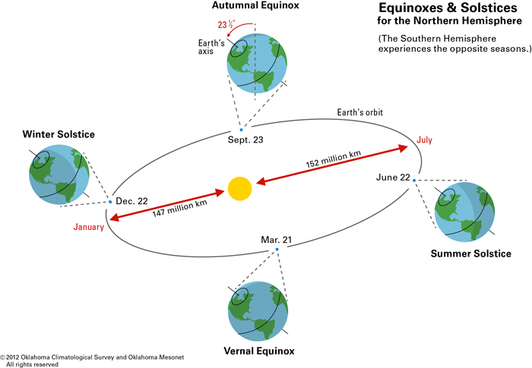
Diagram of Earth/Sun system
Notes:
Shown is a typical diagram of the Sun-Earth system your students might find in their science textbooks. There are many details and system relationships embedded with in the diagram. These details may not be obvious to your students and may require time for them to make all of the connections.
The seasons are marked by the movement of the Earth around the Sun. The Earth’s tilt is 23.5 degrees off vertical and doesn’t change significantly throughout the year. This causes the Northern Hemisphere to be tilted toward the sun in summer and away from the sun in winter. The Earth spins counterclockwise when viewed from above the North Pole. This counterclockwise rotation results in weather patterns moving from west to east.
You can see in the diagram the lines (the axis) at the top and bottom of the Earth are in the same position at each of the four seasons. Notice the blue-gray shadow representing night. The shadow does slide around so that it is on the side of the Earth opposite from the Sun.
You may have students draw their own version of the diagram to access their prior knowledge. Students could pair up to share, compare, and discuss any new insights or corrections. Have students use a different colored pencil to add changes and mark through any incorrect information. Then have 2 pairs join to make a larger group and repeat the process using a third colored pencil for changes. The different colored pencils will help you track what learning occurred at each stage of the activity. Finally, as a whole class, you can create the “class” diagram that ultimately would look like the image provided here by the end of your unit.

Slide 3
If the Sun was a flashlight and the Earth was a beach ball.
Polar Region
Cooler Temps
Less Intense
Warmer Temps
More Intense
Equator
Less Intense
Cooler Temps
Polar Region
Notes:
Students can observe the effects of sunlight striking the surface of the Earth at an angle using a beach ball (or similar spherical object) and a working flashlight. The intensity or brightness of the light where it meets the object is very bright.
They should also see the intensity decrease as they move away from the object and increase as they move closer. The intensity also changes, if the beam of light strikes the surface at an angle.
The tilt of the Earth on its axis has a similar effect on how intense the solar radiation is at each location on the Earth’s surface. When an area of the Earth is tilted towards the sun the solar radiation is more intense; tilted away less intense.

Slide 4
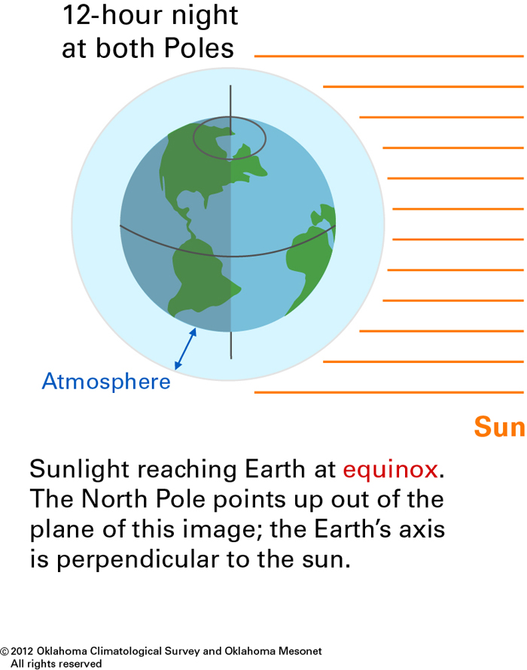
Diagram of Earth Receiving Sunlight on Equinox
Notes:
During the equinoxes, March 21 for Spring and September 21 for Fall, the day is 12 hours long and the night is 12 hours long at all latitudes. From the image shown the Sun’s rays are hitting the Earth’s surface directly at all latitudes. No Sun ray travels a longer or shorter distance to reach the Earth’s surface.

Slide 5
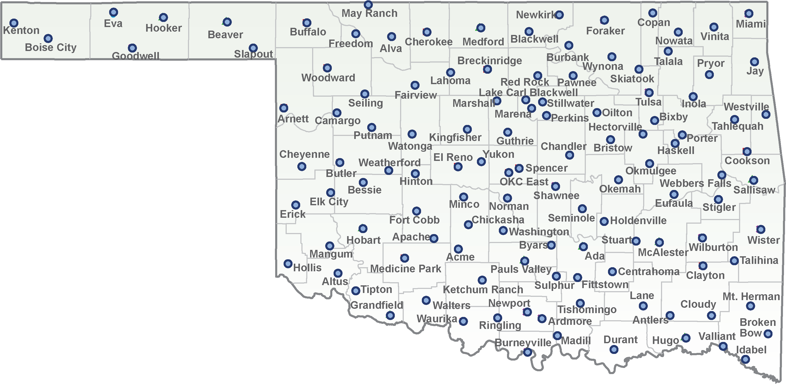
Mesonet Site Locations
Notes:
The Oklahoma Mesonet is a network of weather stations. There is at least one Mesonet tower in each county of Oklahoma. Have your students identify the station or stations in your county.

Slide 6
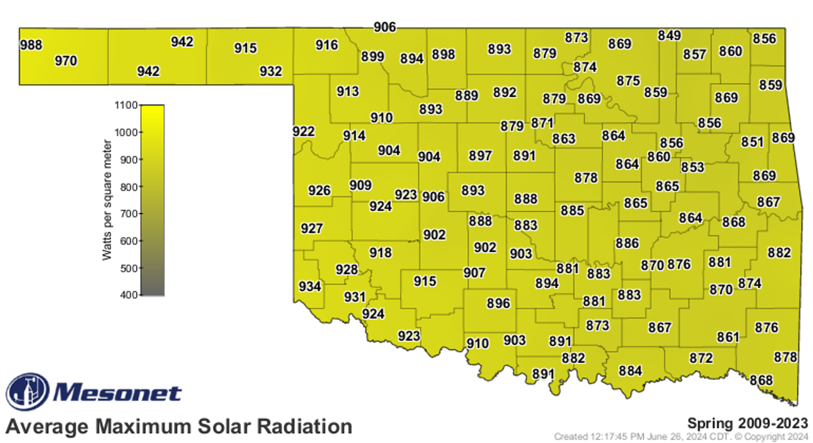
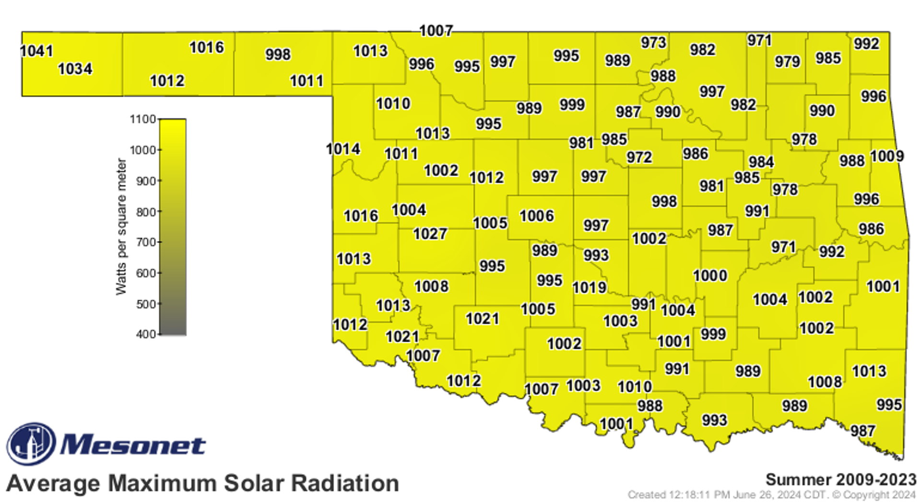
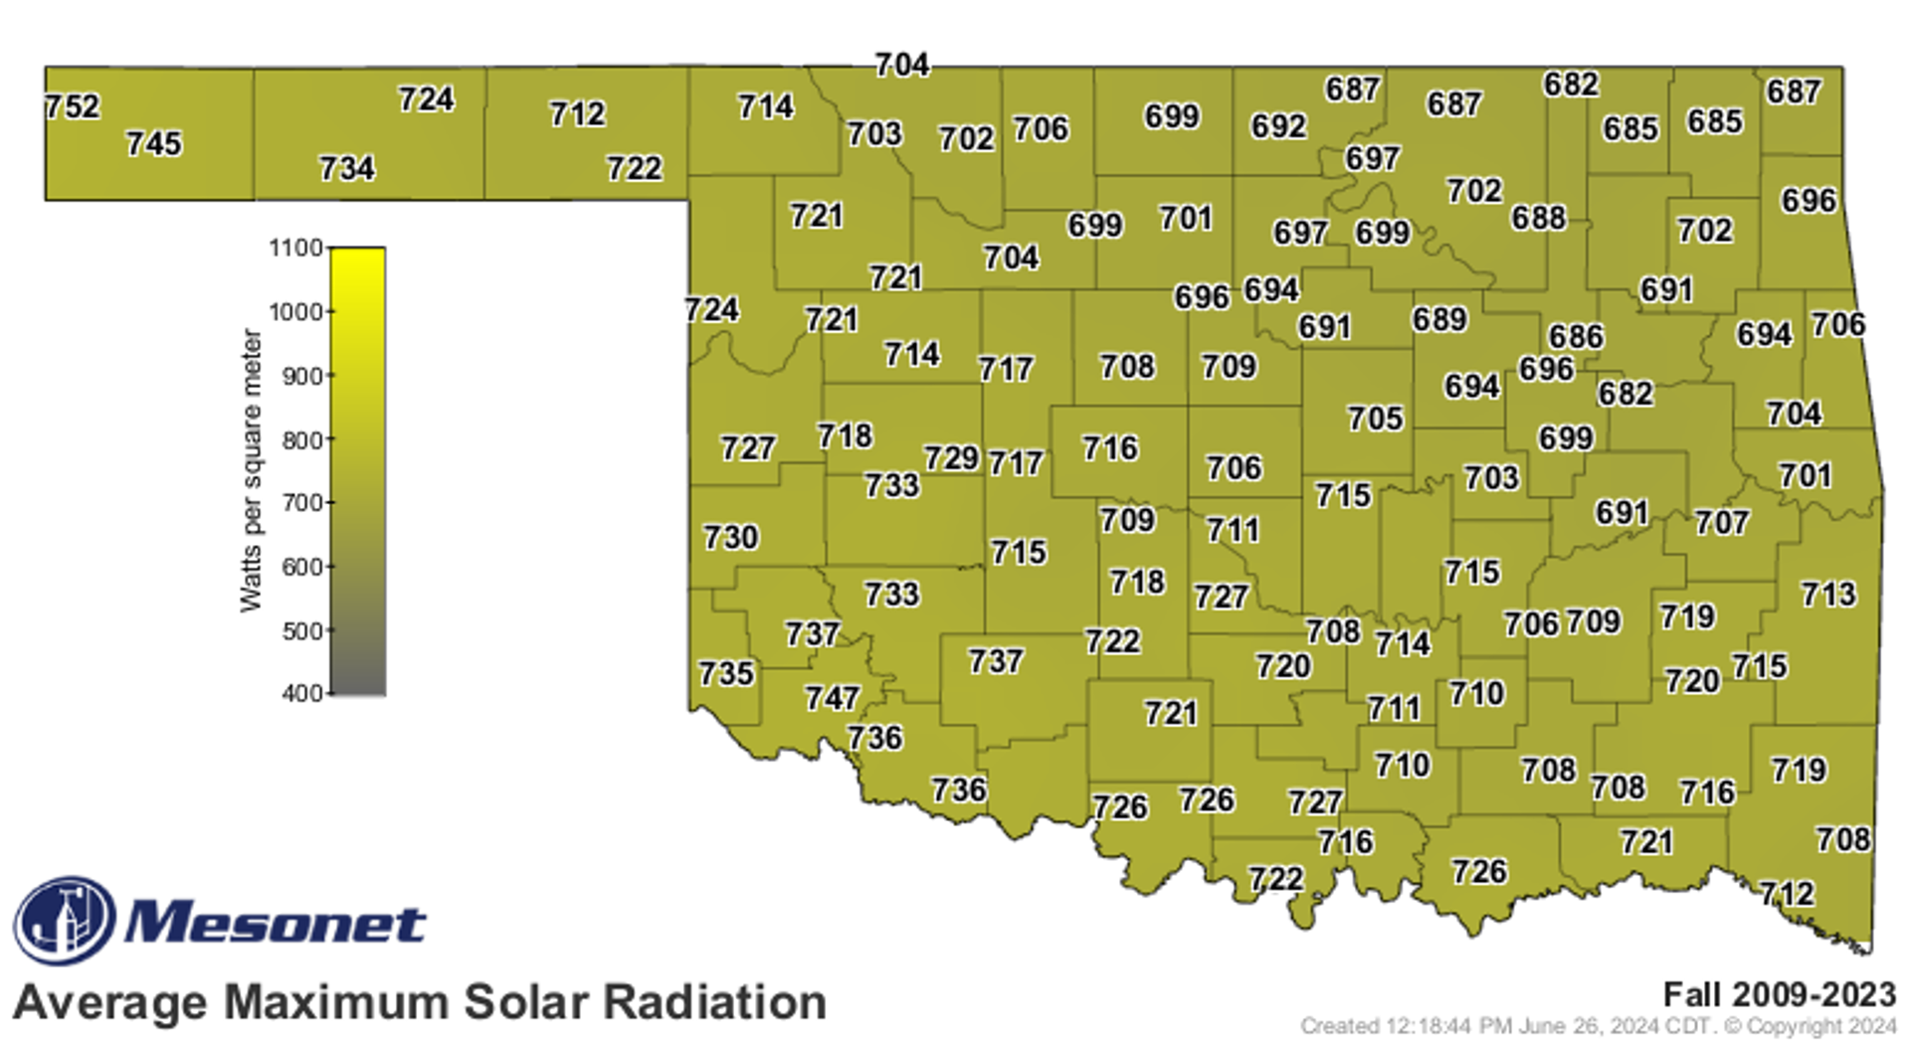
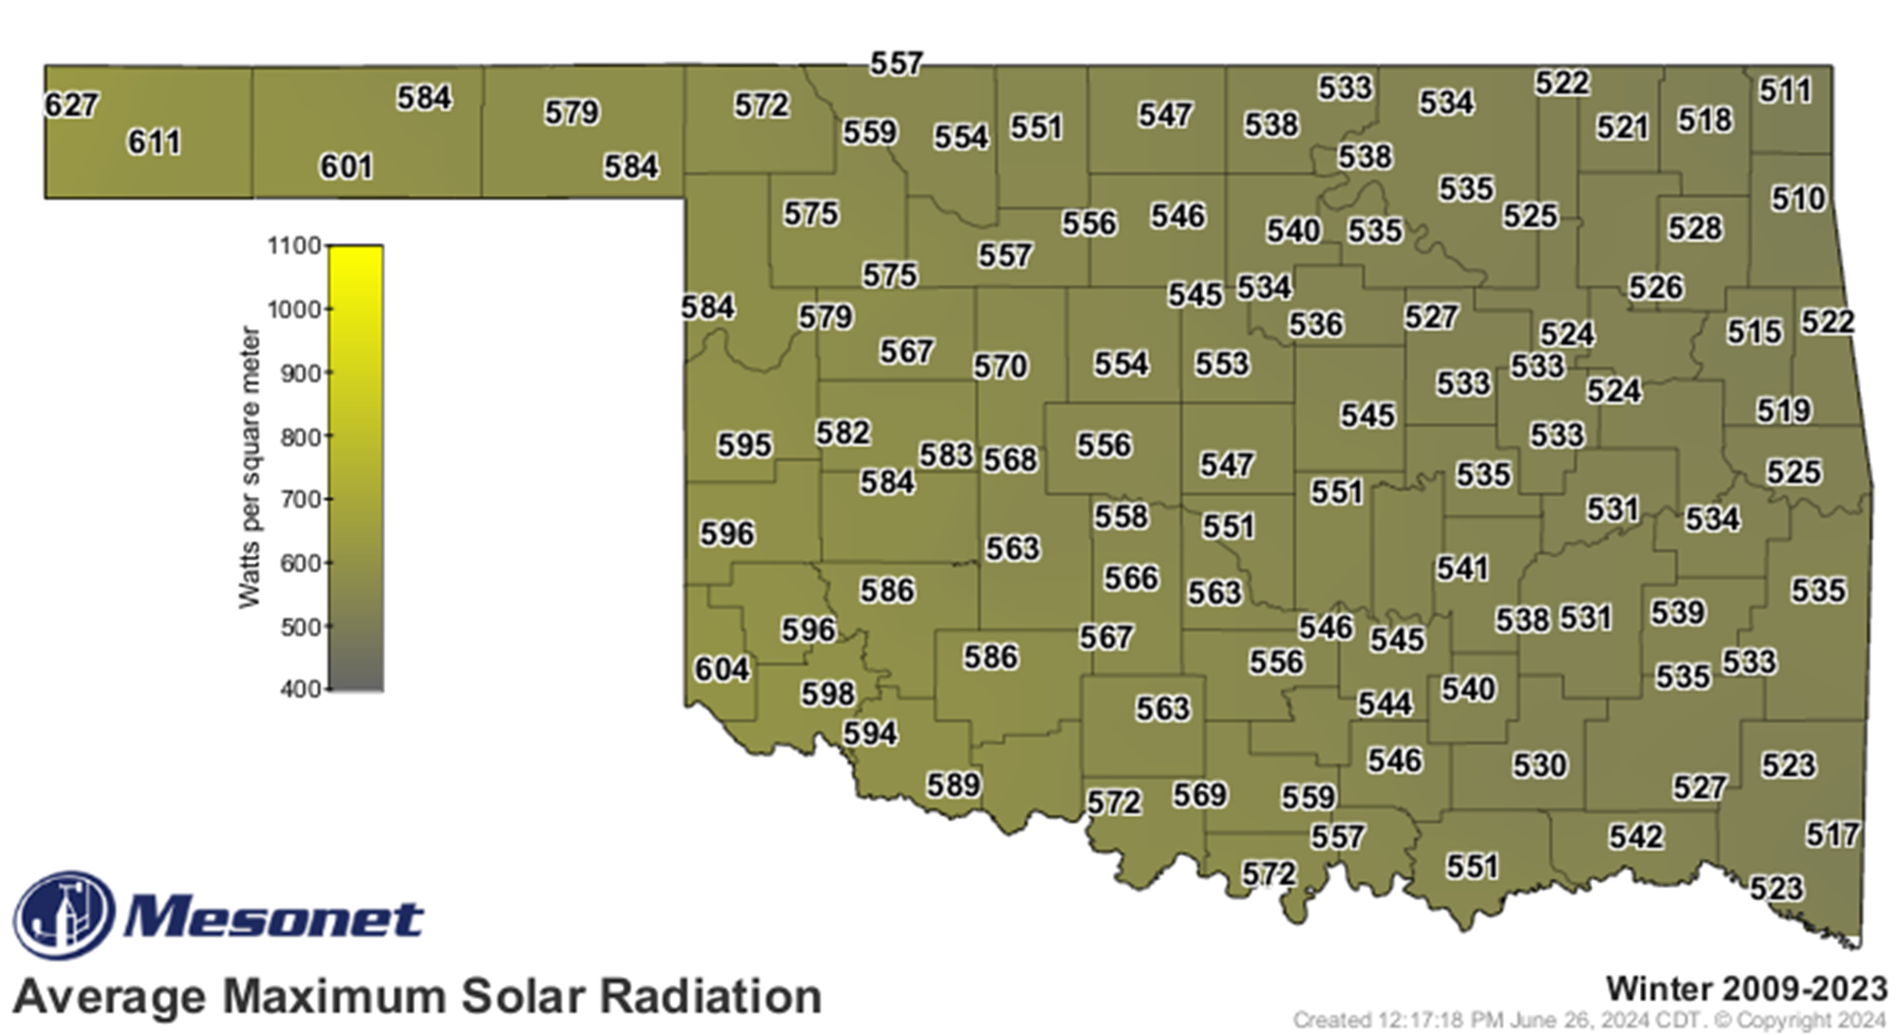
Compare Seasonal Solar Radiation
Notes:
Give your students the four solar radiation maps. Have them locate the Oklahoma Mesonet site in their county and note the average solar radiation by season. Have students discuss whether the values for each season make sense. Is the largest solar radiation value in the summer months when the Earth is titled towards the sun? The following slides show each map individually.
For younger students you will need to help them understand that solar radiation tells us how much sunlight reaches your location. To really help them grasp this concept, try shining that flashlight from before on a piece of notebook paper sitting on the floor. The size of the paper represents 1 square meter. The light from the flashlight represents the number of Watts of energy from the sun. Move the flashlight closer to the paper and then farther away to change the intensity of the beam. If the light on the paper is bright, the value would be a higher Watts per square meter number. If the light on the paper is dimmer, the value would be a lower Watts per square meter number.
For older students, have them generate similar maps (from the long-term average map tool on the Mesonet web site) for individual years. Which year had the highest average solar radiation values? The lowest? Students could research these years to determine if a significant weather event or events, more or fewer cloudy days, would have contributed to the above or below normal conditions.

Slide 7

Spring Average Solar Radiation Map
Notes:
The Oklahoma Mesonet collects solar radiation. Using the long-term averages map tool on the website, you can create maps of solar radiation to use in your classroom. This first map shows the average maximum solar radiation across Oklahoma for the Spring months from 2009 to 2023. The station with the lowest value is Copan with a value of 849 Watts per square meter. The station with the highest value is Kenton with a value of 988 Watts per square meter. What is the value at your closest Mesonet tower? Is the value closer to Copan or Kenton?

Slide 8

Summer Average Solar Radiation Map
Notes:
Next is Summer. The station with the lowest value is Copan with a value of 971 Watts per square meter. The station with the highest value is Kenton with a value of 1041 Watts per square meter. What is the value at your closest Mesonet tower? Is the value closer to Copan or Kenton?

Slide 9
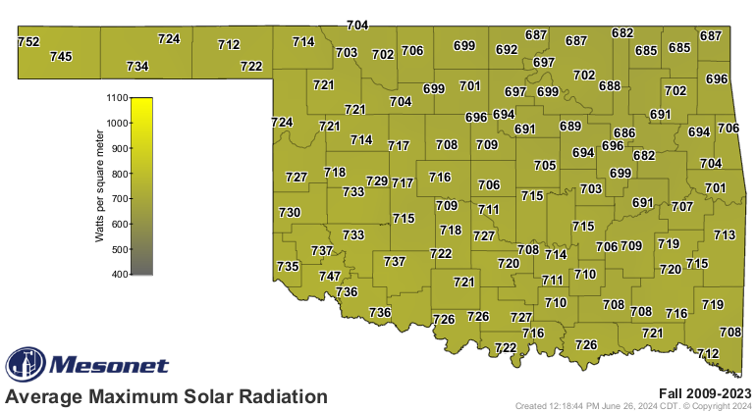
Fall Average Solar Radiation Map
Notes:
Moving into Fall. The station with the lowest value is Copan with a value of 682 Watts per square meter. The station with the highest value is Kenton with a value of 752 Watts per square meter. What is the value at your closest Mesonet tower? Is the value closer to Copan or Kenton?

Slide 10

Winter Average Solar Radiation Map
Notes:
The last map is for Winter. The station with the lowest value station with the highest value is Kenton with a value of 627 Watts per square meter. What is the value at your closest Mesonet tower? Is the value closer to Jay or Kenton?

Slide 11
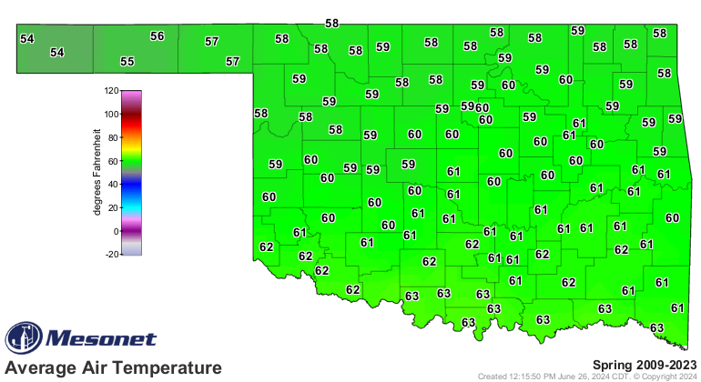
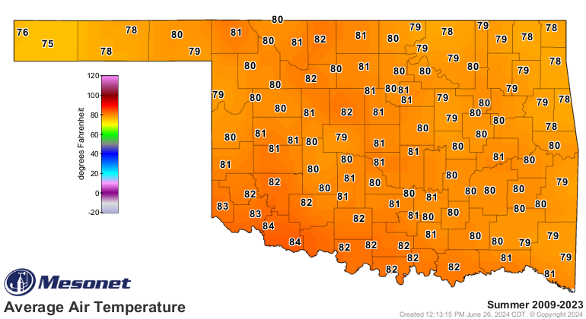
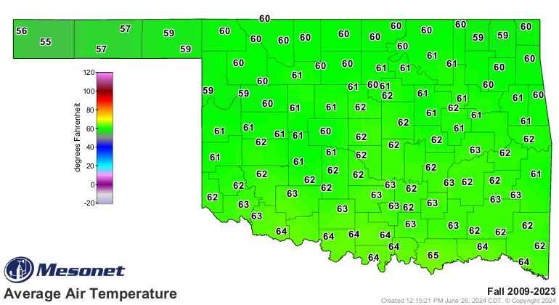
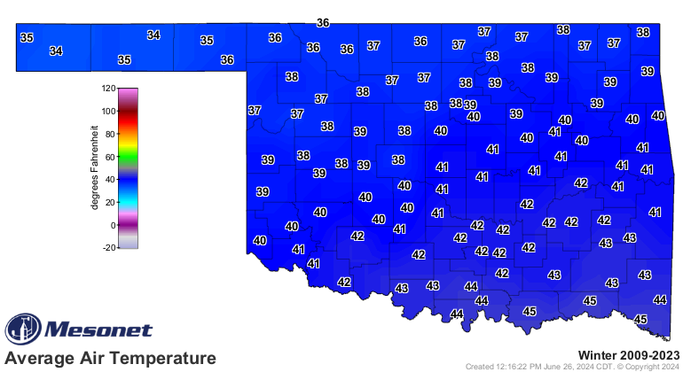
Compare Seasonal Air Temperatures
Notes:
Give your students the four air temperature maps. Have them locate the Oklahoma Mesonet site in their county and note the average air temperature by season. Have students discuss whether the values for each season make sense. Do the warmest air temperatures occur in the summer months when the Earth is titled towards the sun?
For younger students you will need to help them understand that higher temperatures tells us more energy from the sun reaches our location which means we feel hotter.
For older students, have them generate similar maps for individual years. Which year had the warmest average summer temperatures? The coldest? Which year had the coldest average winter temperatures? The warmest? Students could research the warm/cold years to determine what significant weather event or events, the number of clear/cloudy days would have contributed to the above or below normal conditions.

Slide 12
Spring Average Air Temperature Map
Notes:
Solar radiation values have a direct impact on our temperatures. The Sun’s radiation warms the ground. The ground in turn warms the air. We measure heat using thermometers. We refer to these measurements as air temperature.
This first map shows the average air temperature across Oklahoma for the Spring months from 2009 to 2023, the same period we used for the solar radiation maps earlier. The stations with the lowest value of 54°F are Kenton and Boise City. Several stations in southern Oklahoma share the highest value of 63°F. What is the value at your closest Mesonet tower? Is your station’s value closer to 54 or 63°F?

Slide 13
Summer Average Air Temperature Map
Notes:
We see the jump in temperatures for the Summer months. The station with the lowest value of 75°F is Boise City. Two stations, Grandfield and Tipton, share the highest value of 84°F. What is the value at your closest Mesonet tower? Is the value closer to 75 or 84°F?

Slide 14
Fall Average Air Temperature Map
Notes:
Moving into Fall. The station with the lowest value is Boise City at 55°F. The station with the highest value is Durant at 65°F. What is the value at your closest Mesonet tower? Is the value closer to Boise City or Durant?

Slide 15
Winter Average Air Temperature Map
Notes:
The last map is for Winter. The stations with the lowest value are Boise City and Hooker at 34°F. The stations with the highest value of 45°F include Durant, Hugo, and Idabel. What is the value at your closest Mesonet tower? Is the value closer to 34 or 45°F?

Slide 16
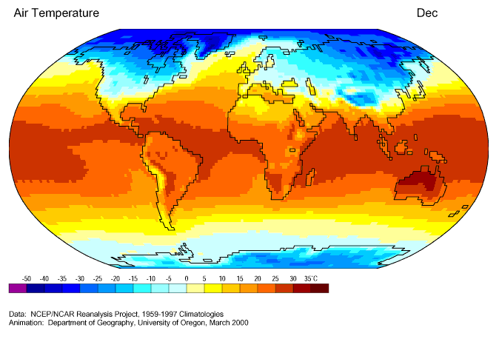
Month-by-month Average Temperature
Why do the warm and cold conditions migrate north and south throughout the year?
Image Courtesy of: http://geography.uoregon.edu/envchange/clim_animations/gifs/tmp2m_web.gif
Notes:
We can see the seasonal changes in temperatures globally in this animation. The warmest temperatures are at the equator. During the winter months, the cold temperatures move southward and during the summer months, the warm temperatures move northward.

Slide 17
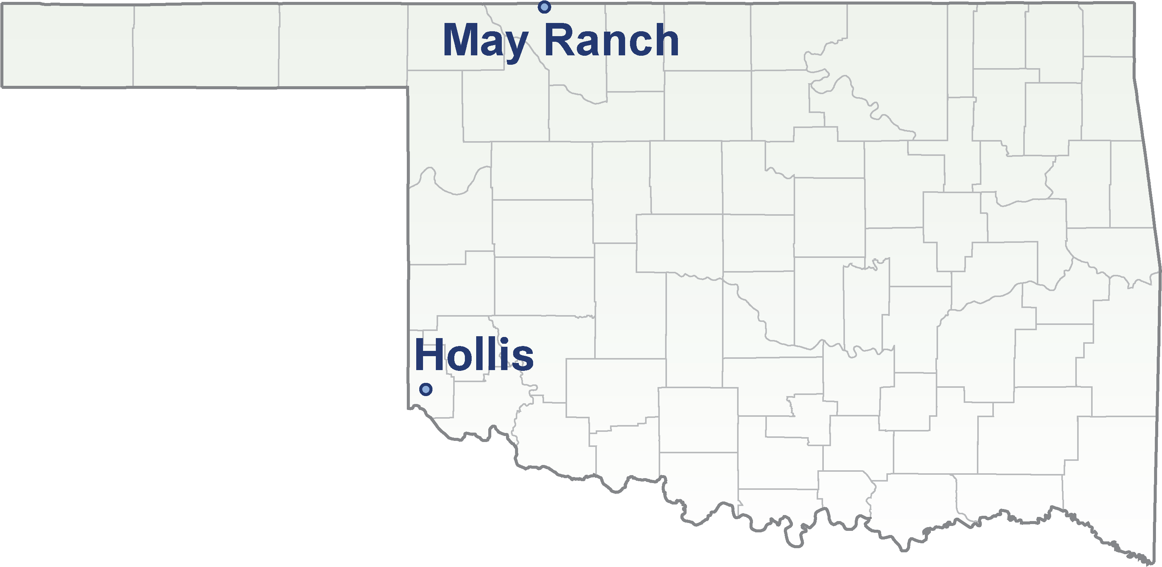
May Ranch and Hollis
Notes:
Here is a map of Oklahoma showing the Mesonet stations – May Ranch and Hollis. May Ranch is located in Woods County near the Oklahoma-Kansas border. It is the farthest north site in the network. Hollis is located in Harmon County in far southwestern Oklahoma along the Oklahoma-Texas border. While Hollis is not the most southern site, being in western Oklahoma it gets a few more clear sky days than Idabel in southeastern Oklahoma.

Slide 18
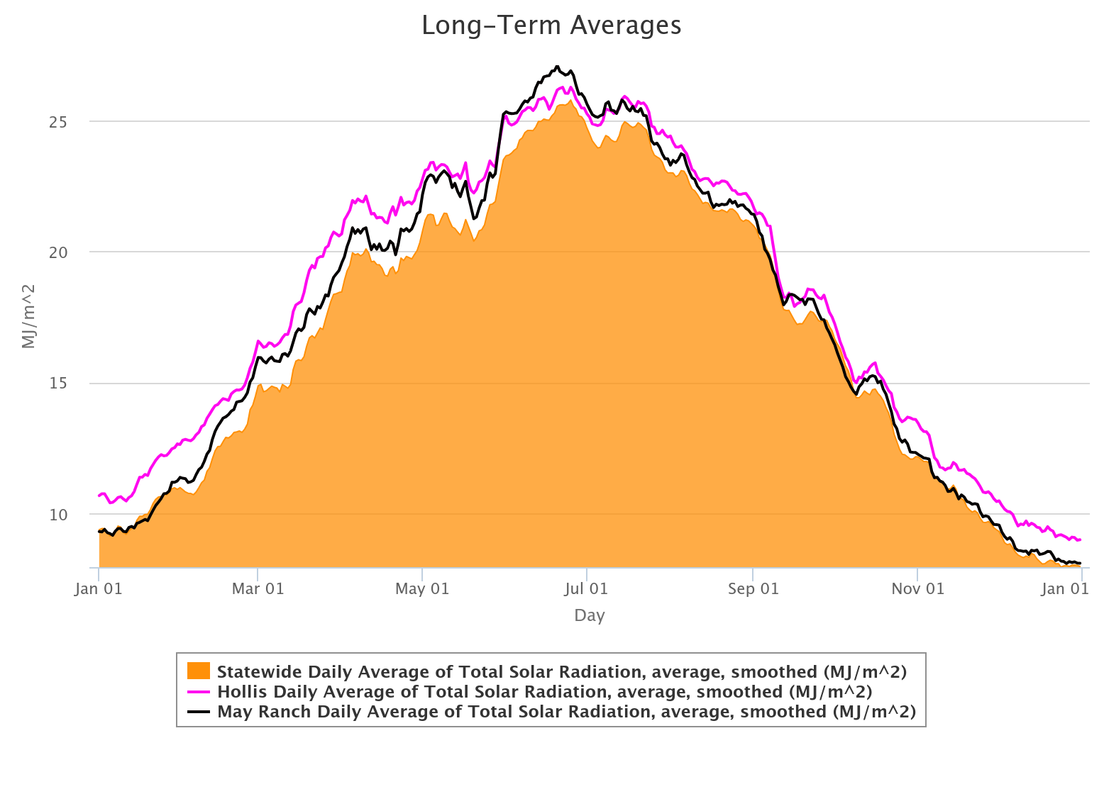
May Ranch and Hollis Total Solar Radiation Graphs
Notes:
Another way we can see changes in solar radiation is with a graph. The orange shaded curve is the statewide, daily average total solar radiation. The curve has been smoothed. The graph shows data beginning with January 1st on the left through the year ending with January 1st of the following year. The pink line is the daily average total solar radiation for the Hollis site. The black line is the daily average total solar radiation for the May Ranch site.
Let’s begin on the left side of the graph on January 1st. Have students note the seasons on the bottom of the graph beginning with January.
For younger students, it might not be obvious that our seasons don’t start and end with the first and last month of the calendar.
In general, are the pink and black lines, above or below the orange curve? Remember, the orange curve represents all stations across the state. Next, for each season, students should record if the Hollis (pink) line is above or below the May Ranch (black) line. Do students notice a pattern? Can they relate this pattern back to the Earth’s tilt?
Because May Ranch is farther north than Hollis, during the winter months, the Earth is tilted away from the Sun causing the Sun’s rays to travel farther and the solar energy is less intense.
During the Spring and Fall months, the pink and black lines are closer to each other showing near equal amounts of solar radiation.
During the summer months, we see the pink and black lines reverse position. The May Ranch site is now benefiting from the Earth’s tilt towards the Sun with higher solar radiation values than Hollis.

Slide 19
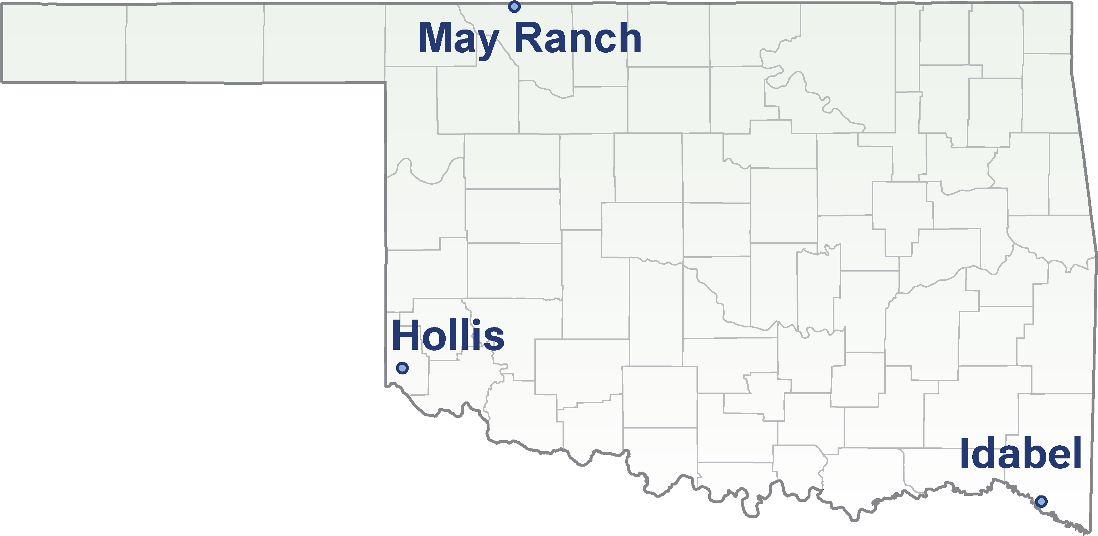
May Ranch, Hollis, and Idabel
Notes:
Here is the map of Oklahoma showing the Mesonet stations – May Ranch and Hollis. Let’s add on Idabel the southern most site. Idabel is quite a bit cloudier throughout the year. How will the Idabel total solar radiation compare to the statewide average?

Slide 20
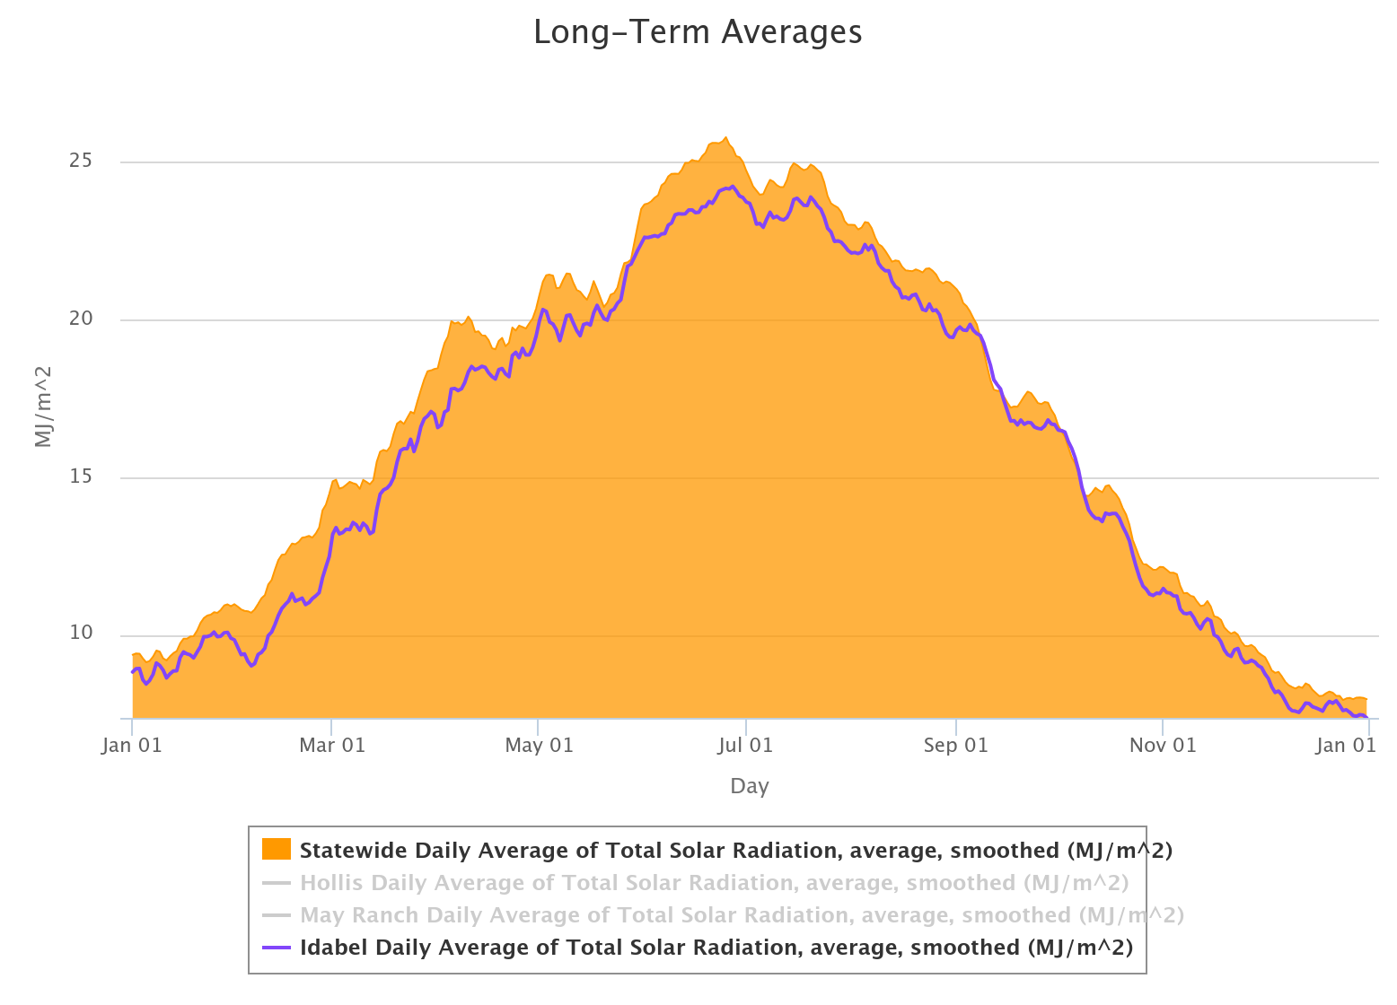
Idabel Total Solar Radiation Graph
Notes:
Remember, the orange curve represents all stations across the state. Next, for each season, students should record if the Idabel (purple) line is above or below the statewide average.
Unlike the graphs for Hollis and May Ranch, the amount of solar radiation at Idabel is impacted not only by latitude but also by the amount of clouds over the site during the year. More cloudy days means the Idabel site stays below the statewide average. This makes it more difficult to see the changes due only to latitude.

Slide 21
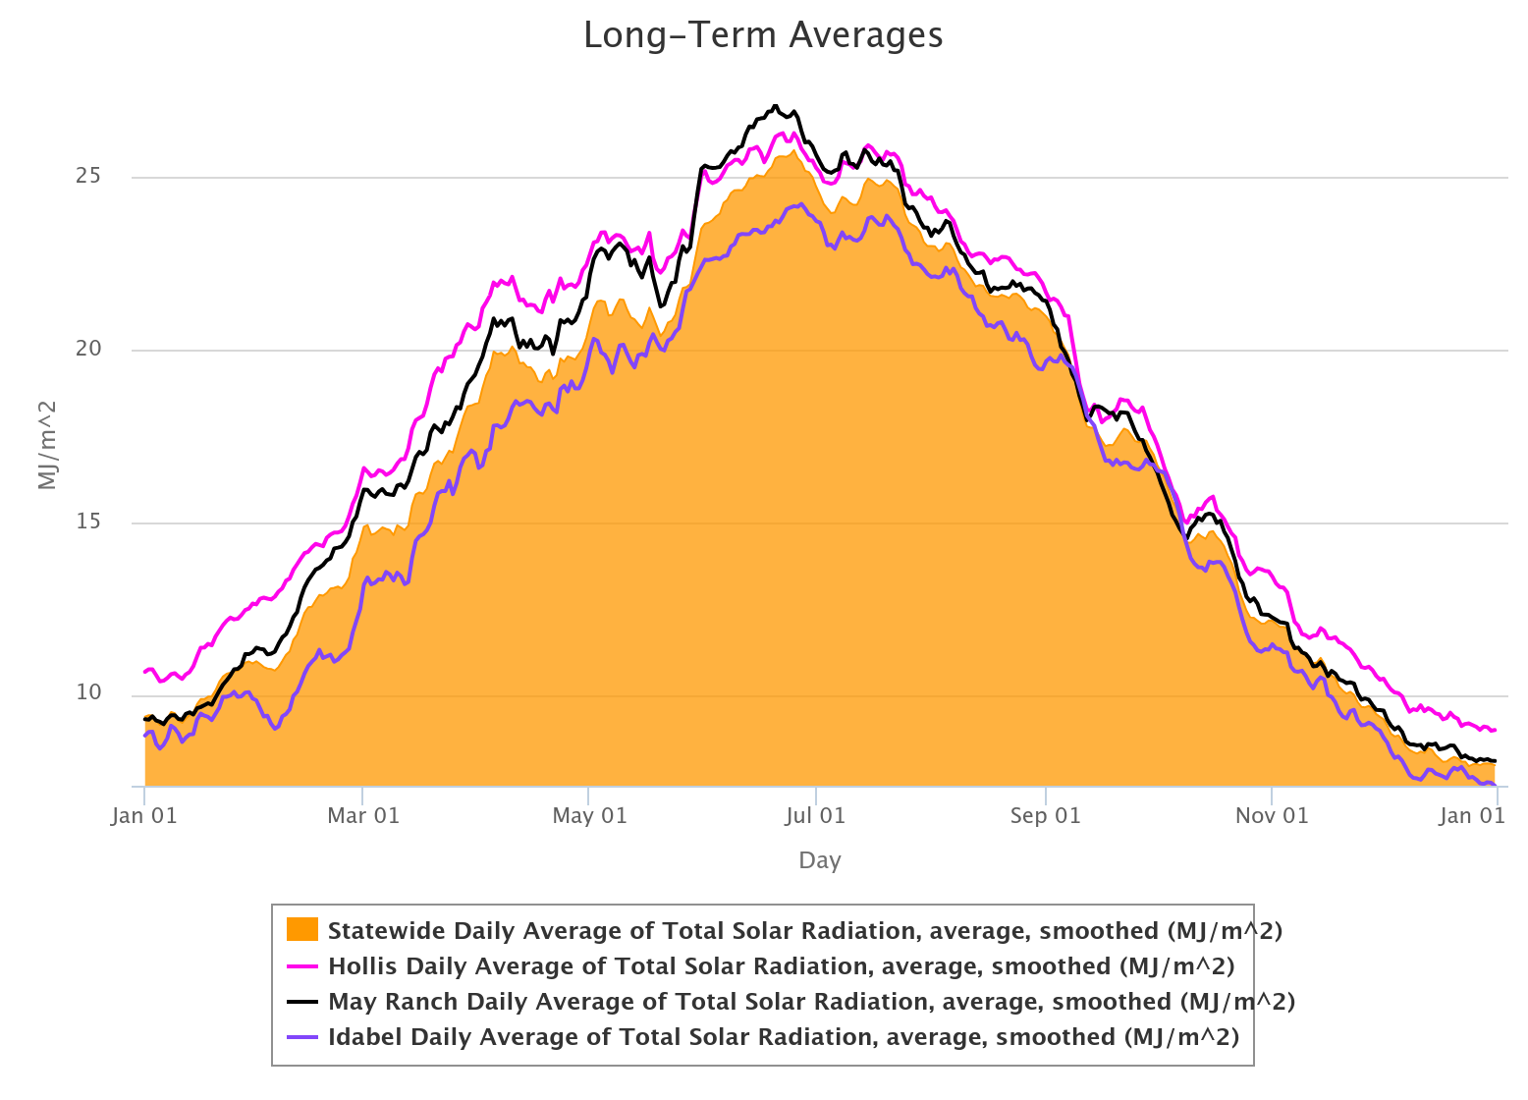
All 3 Sites Total Solar Radiation Graphs
Notes:
OK. Now for the big comparison. The Hollis (pink line) and the May Ranch (black line) have been added back. Hollis and May Ranch graphs stay above the statewide average while Idabel sits below. The cloud cover at Idabel reduces the solar radiation reaching the surface. Therefore, we would expect temperatures to be cooler at Idabel.
Isn’t data great?

Slide 22
Summary Points
Notes:
Let’s summarize the main points.

Slide 23
Seasons Summary
Our seasons are caused by the tilt of the Earth
We have 4 seasons, spring, summer, fall, and winter
  On the Spring and Summer equinoxes, we get 12 hours of daylight, 12 hours of nighttime
  On the Winter solstice, the Northern Hemisphere receives less solar radiation; more nighttime hours
  On the Summer solstice, the Northern Hemisphere receives more solar radiation; more daylight hours
Higher solar radiation = warmer air temperatures
Notes:
Our seasons are caused by the tilt of the Earth. We have 4 seasons, spring, summer, fall, and winter. On the Spring and Summer equinoxes, we get 12 hours of daylight and 12 hours of nighttime.
On the Winter solstice. the Northern Hemisphere received less solar radiation resulting in more nighttime hours.
On the Summer solstice, the Northern Hemisphere received more solar radiation resulting in more daylight hours.
Higher solar radiation equals warmer air temperatures.

Slide 24
High School
Notes:
For high school students, you can bring in some additional math applications.

Slide 25

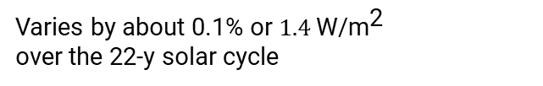
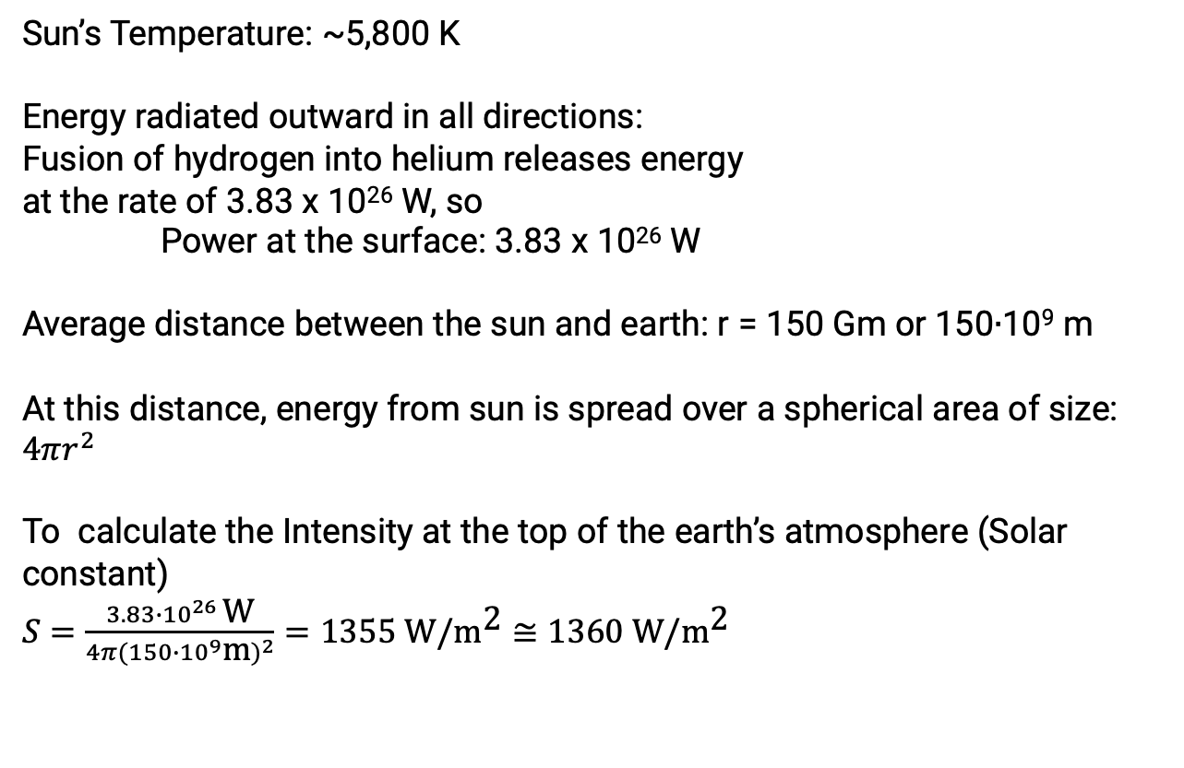
Solar Radiation Calculations
☀️
Sun’s Temperature: ~5,800 K
Energy radiated outward in all directions:
Fusion of hydrogen into helium releases energy
at the rate of 3.83 x 10²⁶ W, so
Power at the surface: 3.83 x 10²⁶ W
Average distance between the sun and earth: r = 150 Gm or 150∙10⁹ m
At this distance, energy from sun is spread over a spherical area of size: $4πr^{2}$
To calculate the Intensity at the top of the earth’s atmosphere (Solar constant)
$S=\frac{3.83∙{10}^{26} \text{W}}{4π{(150∙{10}^{9}\text{m})}^{2}}=1355 \text{W}\text{/}{\text{m}}^{\text{2}}≅$ $1360 \text{W}\text{/}{\text{m}}^{\text{2}}$
r = 150 Gm
🌎
Varies by about 0.1% or $1.4 \text{W}\text{/}{\text{m}}^{\text{2}}$
over the 22-y solar cycle
Notes:
As we’ve shown in this presentation, the energy from the Sun is key to creating our earth’s seasons. A little more advanced topic is to discuss how we quantify the amount of energy we receive from the Sun. The Sun has a temperature of about 5800 K or 10,000°F!
At the Sun’s core, the fusion of hydrogen into helium releases energy at the rate of 3.83 times 10²⁶ Watts. This power is relatively constant, but it is spread out over an ever-larger area as one gets further away from the Sun.
If we want to look at the intensity of the Sun’s power at the earth, we need to take into consideration the Earth’s average distance from the Sun, which is about 150 Giga meters or 150 x 10⁹ meters.
Since the Earth’s energy is being radiated in all directions, we need to imagine a sphere that surrounds the Sun with a radius of 150 Giga meters.
The surface area of that sphere would be calculated as 4 𝜋 r² .
To then calculate the solar constant, we would take the 3.83 X 10²⁶ W of power divided by the surface area of that sphere -- 4 𝜋 times the radius of (150 x 10⁹ m) squared to get 1355 Watts/m², or about 1360 Watts/m² depending on how the values were rounded. This is a good approximation of the amount of solar energy that reaches a unit area on a surface perpendicular to the Sun's rays at Earth's average distance from the Sun.

Slide 26
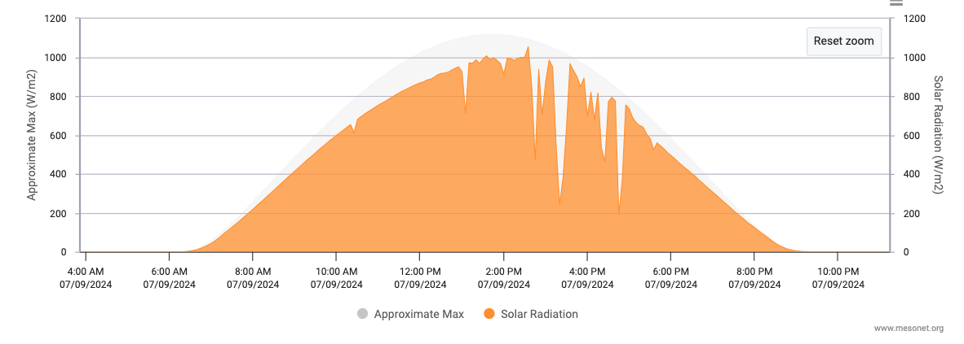
Why do we receive less than 1360 W/m²?
Solar radiation measured at the Woodward, Oklahoma Mesonet station on July 9, 2024
Most direct sunlight around noon
Sunrise
Intermittent clouds
Sunset
The earth’s atmosphere absorbs and scatters some radiation
Some of the solar radiation is reflected back to space by clouds
Notes:
Because the Oklahoma Mesonet measures solar radiation, we can create daily graphs. Once your students become familiar with the tool and begin making graphs on their own, there are endless data analysis projects for them to explore. They can compare different years at the same site, compare sites in different regions of the state, or determine which month of the year a site is cloudiest. How many clear sky days occur each year? Is the number of clear sky days increasing? Are clear sky days increasing more during a particular season?
The graph shown is for the Woodward site from July 9th, 2024. As you move in toward the center of the graph from the left and right sides, the 0 W/m² represent the nighttime hours.
As you approach the 6:30 am time, the solar radiation value begins to increase at sunrise. On the right, you can see the solar radiation value again approach 0 W/m² at sunset.
In the middle of the graph, around noon local time, the solar radiation value is at the daily maximum. Notice that the curve is not completely smooth. The jagged valleys indicate that clouds were present blocking some of the solar radiation from reaching the sensor.
What is the maximum value measured at Woodward? How does that compare to the solar constant we calculated previously? Remember the solar constant is 1360 W/m². Why is Woodward receiving less solar radiation than expected?
Those breaks in the curve give us some clues. First, the atmosphere absorbs and scatters some of the radiation before it reaches the Earth’s surface or the sensor. Secondly, the clouds overhead at Woodward will reflect some of the solar radiation back to space.

Slide 27
Resources for Viewing Long-term Averages
Notes:
We encourage you to explore with data beyond what we provided in this module.

Slide 28
Long-term Average Map Tool
https://mesonet.org/past-data/mesonet-resources/
Notes:
Build your own long-term average maps with the map tool in the Past Data - Mesonet Resources section of the Oklahoma Mesonet website. The tool can be used to create solar radiation and air temperature maps for a single year, for a month from a particular year, or a season during a year.

Slide 29
Long-term Average Graph Tool
https://mesonet.org/past-data/mesonet-resources/
Notes:
You can create a long-term average graph comparing a single Mesonet site over multiple years or compare multiple sites for the same year. Graphs can be made of solar radiation and air temperature along with other variables measured. The graph tool is found in the Past Data – Mesonet Resources section of the Oklahoma Mesonet website.

Slide 30
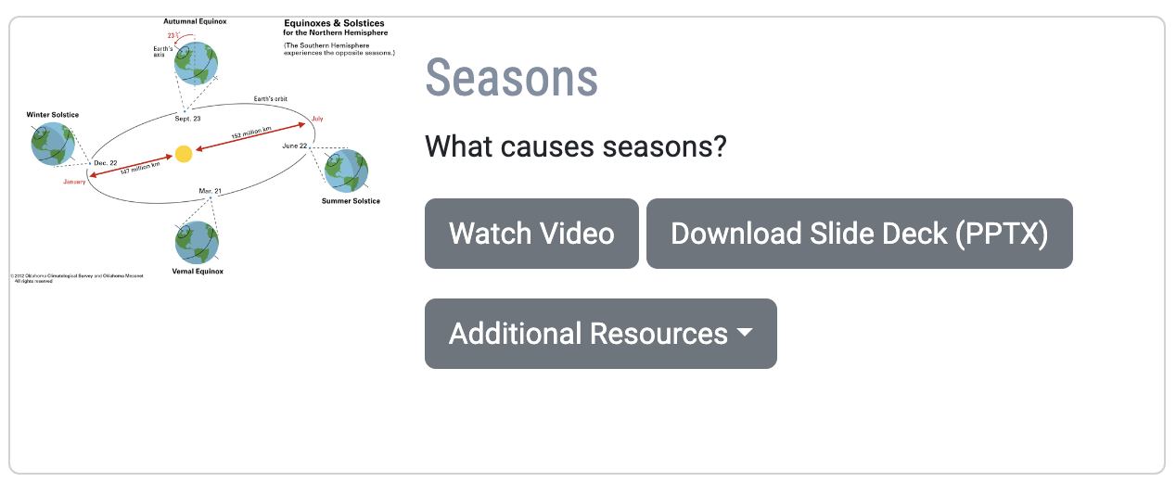
Mesonet K-20 Learning Modules
https://mesonet.org/education/learning-materials/
Notes:
Along with this video, you will find the slide deck used and links to other documents, images, and animations in the K-20 - Learning Modules section of the Oklahoma Mesonet website.
Do you have an idea for a new module topic? We would love to have your feedback for any of our learning materials. Use the Contact form under the More menu of the Mesonet website. Select K-20 Education for the Inquiry Type then enter your comments, questions, or suggestions.
You have completed the Seasons module. I hope you will join us for another Learning Module soon. See you next time.

