Slide 1
Weather Radar Basics
Notes:
Welcome to the learning module on weather radar basics. I’m meteorologist James Hocker, and I’ll be your presenter.

Slide 2

Yelling in a Canyon
HELLO!
HELLO!
HELLO!
HELLO!
Image courtesy of: http://www.canyontours.com/wp-content/uploads/2013/09/West-Rim.jpg
Notes:
Ok, so we have all done this at some point in our lives, right? Maybe you tried it at a scenic canyon like the one shown here or perhaps in a large empty room with hard floors and bare walls. You yell out the word hello and shortly after you hear the word echo back several times, each time a little more faint than the last.

Slide 3
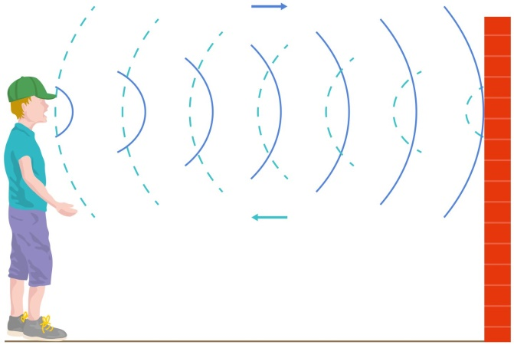
Sound Echoing Off Wall
Image courtesy of: http://res.cloudinary.com/dk-find-out/image/upload/q_80,w_1440/Sound-3_qrd2ed.jpg
Notes:
The sound waves leave our mouth and travel away from us until hitting an obstruction such as the one shown in the example here. With a nice flat obstruction, the sound waves are reflected and directed mostly back towards us which we then experience as an echo. Our volume, the shape of the obstruction, and our distance away from it are all factors that influence how quickly and clearly we hear our echo.

Slide 4
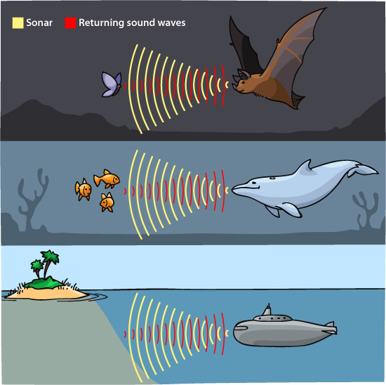
Sonar
Sonar: sound navigation and ranging
Image courtesy of: http://askabiologist.asu.edu/sites/default/files/resources/articles/bats/ecolocation_types.jpg
Notes:
There’s a name for this phenomena and you have likely heard it before – sonar. But did you know that the word sonar is an acronym? It stands for sound navigation and ranging. It’s essentially the process of detecting targets at some distance away using sound waves and then determining their distance away based on the time delay in receiving sound waves back. There are numerous examples of using sonar both by humans as well as wildlife. Humans use it in many naval applications to detect obstructions in the ocean while clever wildlife exploit it for the detection and location of prey to assist them when hunting.

Slide 5
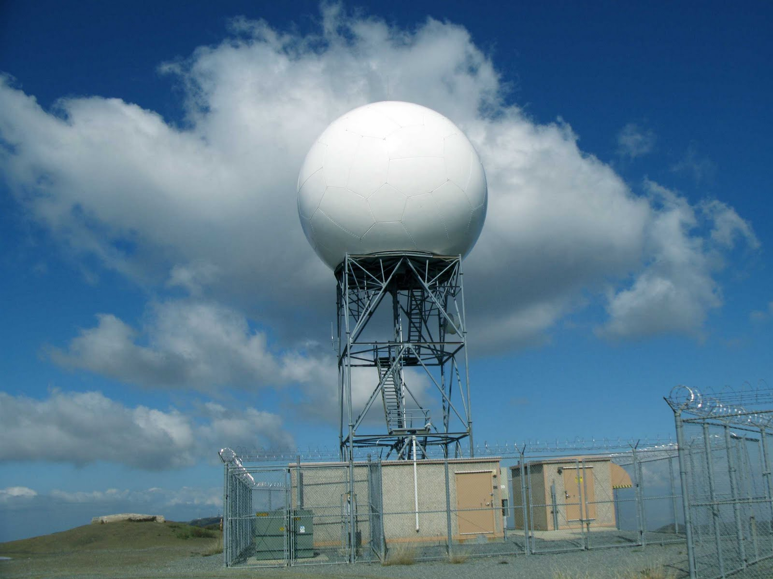
Weather Radar
The concept for radar is similar but doesn’t use sound waves
Radar: radio detection and ranging
Notes:
So you may be asking yourself, why all this talk about sonar in a radar presentation? Well, it turns out that the two are quite similar in that they both represent a process of sending a signal out and waiting for that signal to return to it. However, in the case of radar, it does not involve sound waves but rather microwave energy. So, the concepts are really very similar, they just involve different types of waves. Even the names are similar as they are both acronyms. In the case of radar it stands for radio detection and ranging.
Shown here is a picture of a National Weather Service radar atop a metal pedestal. The white ball on the top is a protective cover called a radome. It is transparent to the signals the radar sends out and keeps it safe from all the elements. On the inside of the radome is a large metal dish similar to a home tv satellite dish. This dish sends and receives radar pulses while also rotating 360 degrees repeatedly to observe weather phenomena all around it.
On the coming slides we’ll explain a bit more about how a weather radar works.

Slide 6
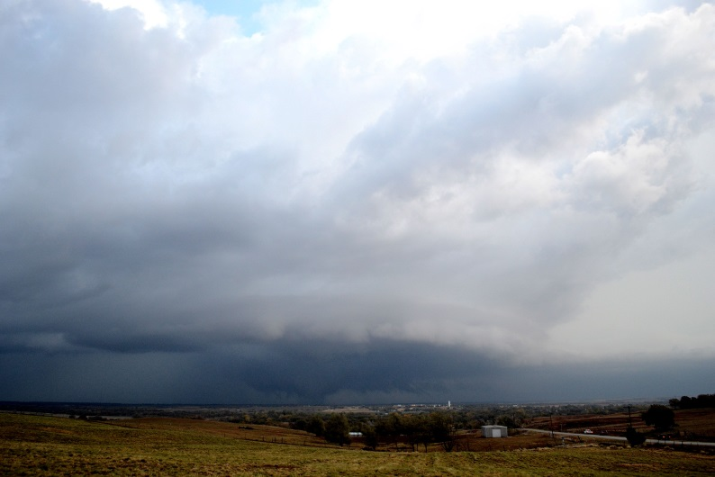
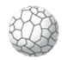
How a Weather Radar Works
750,000 Watts
(National Weather Service radars)
The radar transmits a pulse of microwave energy
Process is repeated 1000 times per second
Notes:
Weather radars come in different sizes with slightly different specifications, but ultimately the basics of how they work is the same. Radars that are a part of the National Weather Service’s NEXRAD network transmit a powerful 750,000 watt pulse of microwave energy. The pulse lasts an extremely short period of time and travel at the speed of light. In total more than 1000 pulses are transmitted every second. In fact, the transmission period of the radar is so short that for every hour a weather radar transmits for approximately 7 seconds while the remaining 59 minutes and 53 seconds are spent listening.

Slide 7
Energy Scattering
Most of the radar’s energy goes right on through!
A portion of the radar’s energy is scattered in all directions
Notes:
Despite the 750,000 watts of microwave energy the radar transmits, most of the signal goes right on through the sky or objects it encounters, which we never receive back. However, a portion of the radar’s energy ends up getting scattered in a variety of directions both upward, downward, and even back towards the radar.

Slide 8
Radar “Echoes”
The tiny amount of energy scattered back to the radar is called an “echo”
The echo is what is used to make the radar images we see
Notes:
The small amount of back-scattered energy that returns to the radar is called an echo. Again, it’s not a sound wave, but it behaves similarly to one, so the word echo is fitting. For all the powerful microwave energy that a weather radar sends out, ultimately the tiny echo that is received back is what is used to make the radar images we all rely on.

Slide 9
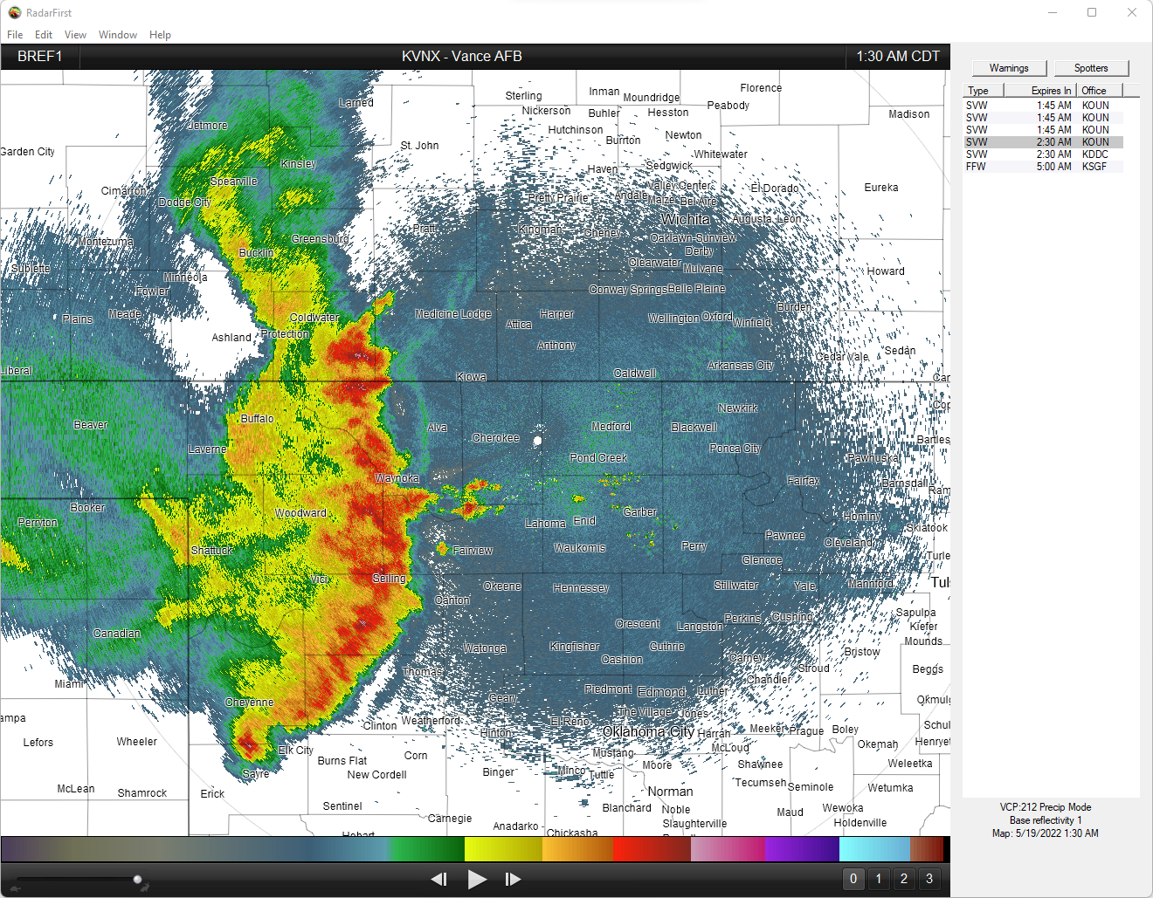
The Result of All That Hard Work
Notes:
Thanks to lots of hard work by a weather radar sending out more than 1000 pulses of energy per second while also rotating 360 degrees, an image like this one can be created. The radar completes a sweep like this in under a minute. After it completes this there is a lot more work to do including scans at higher angles so it can view conditions at multiple different altitudes in the sky. A weather radar can complete a full volumetric view of the sky – something called a volume coverage pattern - in 5 to 10 minutes depending on the specific scanning strategy National Weather Service meteorologists have selected on a given day.

Slide 10

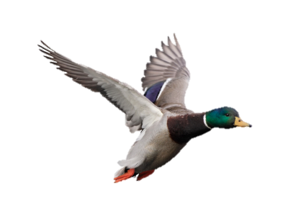
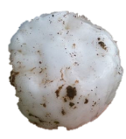
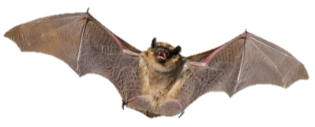


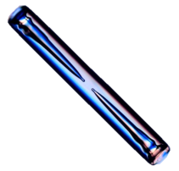

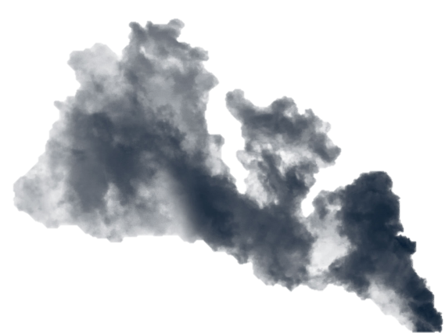
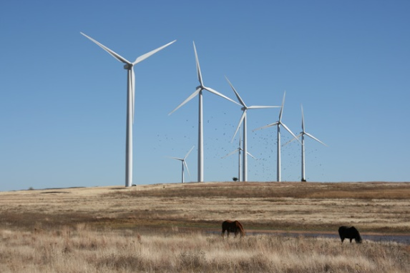
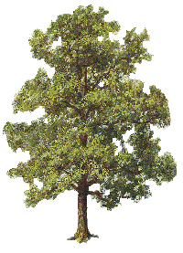
We See LOTS With Weather Radar!
A Radar Beam Bounces Off Of…
  Precipitation: rainfall, hail, snow, sleet, etc.
  Non-precipitation: trees, dust, smoke, birds, bugs, bats, windfarms, planes, buildings, etc.
Notes:
But keep in mind that while a weather radar is designed with the intent of observing precipitation phenomena such as rainfall, hail, snow, and sleet, those aren’t the only features that radar beams bounce off of. Many other non-precipitation features can be observed with weather radars including trees, dust, smoke, birds, bugs, bats, windfarms, planes, buildings, and others.

Slide 11
3 Fundamental Radar Measurements
Range (distance)
Reflectivity (intensity)
Velocity (motion)
Notes:
Next up, let’s briefly cover the 3 fundamental weather radar measurements. These measurements are central to using data from a weather radar and include range, reflectivity, and velocity.

Slide 12
Fundamental Measurement #1: Range
These echoes took longer to return, so they are farther away
Here is the radar
These echoes returned to the radar quickly, so they must be close to the radar
Notes:
The first fundamental weather radar measurement is range. Given we know the speed of the radar’s pulse, the radar can determine how far away different objects are based on how long it takes for the pulse to return to the radar site.
For instance, in the radar image shown here the radar site is located near the center of the image. When it sent pulses towards the south and west, there was very little delay in that pulse going out and returning back to the radar given how close it was. Meanwhile, pulses traveling to the north and west up in Kansas took considerably longer to return to the radar which indicated that those echoes were much farther away.

Slide 13
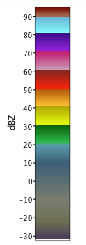
Fundamental Measurement #2: Reflectivity
Reflectivity indicates the intensity of radar targets and is related to the precipitation size and amount
Less intense
Hail
Heavy
Even less intense (non-precipitating)
Moderate
Light
Non-precipitating
Very intense
Notes:
Fundamental weather radar measurement number 2 is reflectivity. This particular measurement tends to be what most people associate with the word radar as it’s the most common measurement shown during weather coverage on TV. Reflectivity is a measure of how intense the various particles are in the atmosphere and is related to both the size and the amount of targets in the sky.
Towards the left side of the slide, you’ll see a colorful legend showing the reflectivity scale. The lowest values tend to be caused by non-precipitating returns to the radar, such as those caused by particulates, dust, bugs, and other very small targets. Once we reach roughly 15 dBZ on the legend and higher we start to observe precipitation targets. You can see how as the reflectivity number increases, the precipitation intensity increases along with it again since reflectivity is largely a measure of intensity.
Relating the legend on the left side to the radar image towards the right, you can see how the higher reflectivity values are associated with the most intense precipitation and storms while the lower reflectivity values are associated with much less intense precipitation. There are even some low reflectivity values right around the radar site - these are non-precipitating and caused by particulates and other small targets reflecting a small amount of the radar’s energy back to it.

Slide 14
Fundamental Measurement #3: Velocity
Doppler Effect:
  A change in frequency when the observer and the energy source are in motion relative to each other
Situation | Observer | Energy Source | Frequency Change
NASCAR | Microphone | Stock car | Change in pitch
Live by train tracks | Ear | Locomotive whistle | Change in pitch
Particles in wind | Radar beam | Radar targets | Change in received wavelength
Notes:
The third fundamental weather radar measurement is velocity, which provides us with information on wind speeds and directions in the atmosphere. This is determined using the Doppler effect. The table here shows different examples of the Doppler effect in action. You’ve likely experienced this effect many times throughout your life as a shift in the pitch of sound as a train or a car passes you by. Since weather radars don’t use sound waves, the Doppler effect in this case relates to the change in the received wavelength of the radar beam as it reflects off objects moving towards it or away from it.

Slide 15
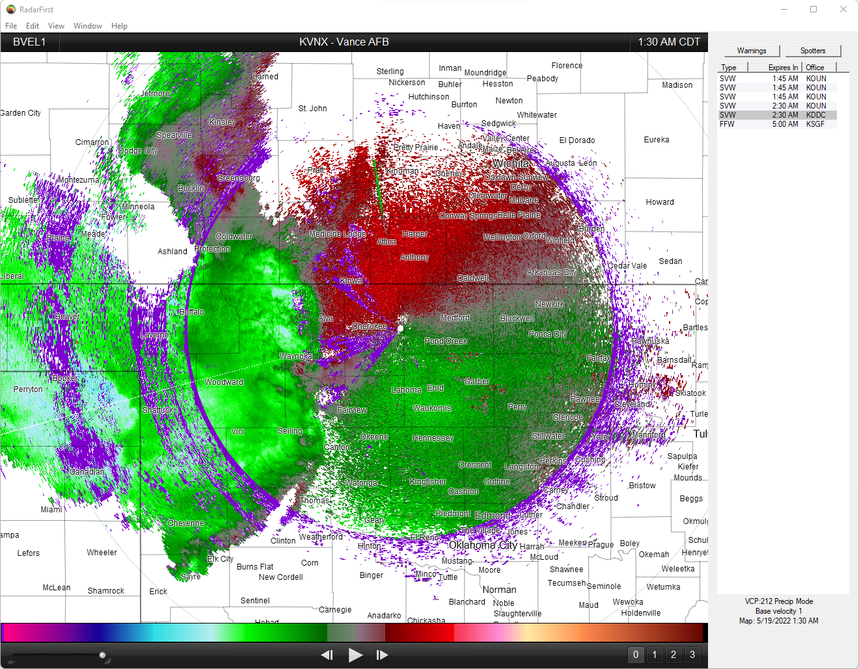
What the Reds and Greens Mean
Velocity shows motion toward and away from the radar
Motion away from the radar
Motion toward the radar
Here’s the radar!
Motion toward the radar
Notes:
Here’s an example of what radar velocity data look like – images like this are sometimes shown during severe weather coverage on TV. The green colors correspond to winds moving toward the radar, while the red colors correspond to winds moving away from the radar.
If you ever view a radar image like this, the first step to properly interpret it is to find the location of the radar producing the image, which in this case is right in the middle of the picture. From there, as long as we know what red and green mean we can decipher the wind. For instance, there is a batch of greens south and east of the radar, so winds in this location are from the southeast coming towards the radar. Meanwhile there are reds north and west of the radar, so these are the same winds from the southeast but this is our view of them after they have passed us by. Meanwhile, further west of us we see another batch of green colors. These correspond to a large region of winds moving from the west to east coming directly towards the radar site.
Ultimately velocity images like these are best to use when also viewing radar reflectivity so that we can understand what winds are doing in relation to the location and intensity of storms and precipitation.

Slide 16
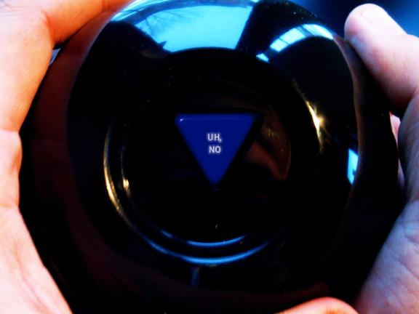
So Radar is Perfect, Right?
Notes:
Weather radar is a wonderful tool that greatly enhances our ability to monitor and observe precipitation features. But is it perfect? Like all technologies, absolutely not!

Slide 17
As Great As It Is, Radars Are Not Perfect
Several fundamental radar sampling issues…
  Beam Height with Distance
  Beam Broadening
  Beam Blockage
Notes:
There are a collection of radar sampling issues that are important to be aware of when using weather radar. Though this is not an exhaustive list, three particularly important sampling issues are beam height with distance, beam broadening, and beam blockage. In the coming slides, we’ll cover each of these and how they influence the imagery you see from weather radars.

Slide 18
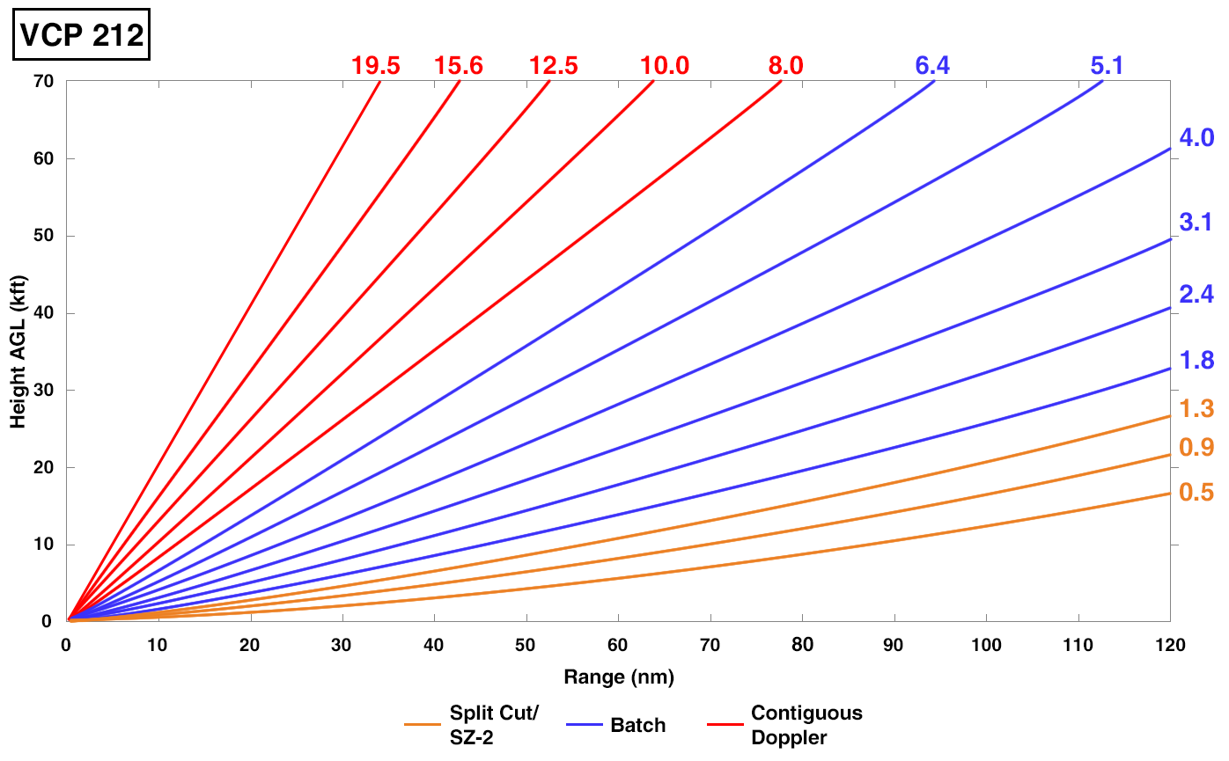
Beam Height with Distance
Normal Atmospheric Conditions
Within 10 miles, the radar cannot see above 20,000 ft
“Cone of silence”
Beyond 90 miles, it cannot see below 10,000 ft “Overshooting”
NWS Warning Decision Training Division (WDTD) RAC Training Course retrieved at https://training.weather.gov/wdtd/courses/rac/intro/88d/story_html5.html on May 5, 2020.
Notes:
The most fundamental radar sampling issue is called beam height with distance. Under normal atmospheric conditions as the radar beam leaves the radar site, it travels upward in the sky. This means that depending on where you are looking on a radar image, the data represent information at different heights in the sky.
In the image you see here, the radar is located in the lower left corner of the image with the x-axis representing the distance away from the radar in nautical miles and the y-axis representing the height above ground level in thousands of feet. The various colored lines starting in the lower left and going up and to the right from there represent each of the different scans that a weather radar completes while operating. Each line is called a tilt and represents a full 360 degree sweep of the radar at that elevation. Looking at all the lines together, you get a feel for the vertical coverage of a radar site as well as where a weather radar can’t see.
For instance, at 10 miles away from a weather radar, none of the tilts measure any higher than 20,000 feet in the air. This region above the radar is something called the cone of silence. Meanwhile, much further away from a weather radar, say at 90 miles, the radar can’t see anywhere from the ground all the way up to 10,000 feet in the air. We call this issue overshooting as anything in the lowest part of the atmosphere is not observed since it sits below the radar beam.

Slide 19
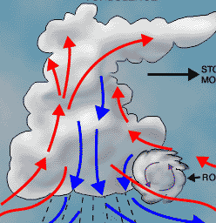
Radar Horizon Problem
Features can be overshot (or undershot) just because of their distance from the radar
Also called the “Radar Horizon Problem”
Notes:
19
Of course, if we also keep in mind that we live on a sphere, we can see that this beam height with distance issue is further exaggerated.
Ultimately what a weather radar will observe is highly dependent on how close the particular feature is from the radar. If a storm is near a radar, we will observe its lowest portions but we will miss its middle and upper portions. Conversely, if a storm is far from a radar the middle and upper portions will be sampled, but the lower portions will be completed missed. We call this the radar horizon problem.

Slide 20
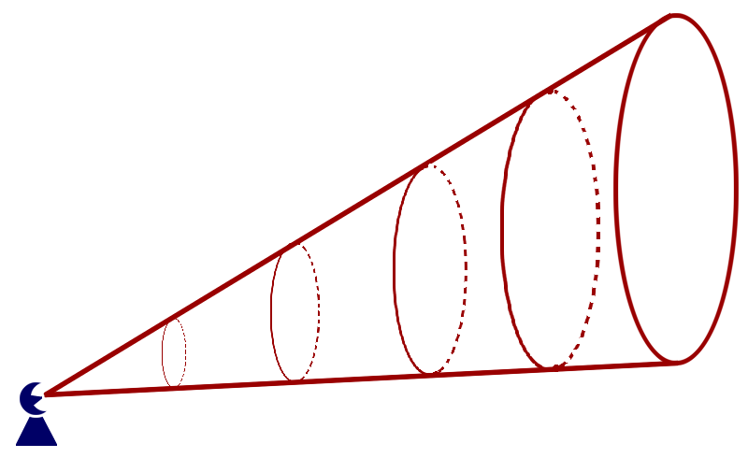
Beam Broadening
The radar beam acts like a cone that gets bigger as it moves away from the radar
It measures an increasingly larger volume of air as it gets farther from the radar
Notes:
The second fundamental radar sampling issue is called beam broadening.
Radar beams are much like flashlight beams – they get larger and larger as they move away from their starting point as shown in the image here. This means that radars measure an increasingly larger volume of air as they get farther and farther away. This greatly impacts their ability to see different features at varying ranges.

Slide 21
Importance of “Filling the Beam”
Let’s introduce an identical set of rain drops into different segments of the beam
Where do you think the radar will be able to see the rain most clearly?
The better the target “fills the beam” the easier it is for the radar to see it
Notes:
For instance, if we introduce an identical set of rain drops into different segments of the radar beam as shown in the image here, where do you think the radar will be able to see the rain most clearly?
Though the 2 sets of raindrops are identical, it turns out that the set closer to the radar is easier to see as it fills the radar beam more completely. With the beam occupying more space farther away, the targets occupy less of its volume and result in a weaker echo. This serves as an important reminder that the same phenomena can appear significantly different to the radar depending on how far they are from the radar site.

Slide 22
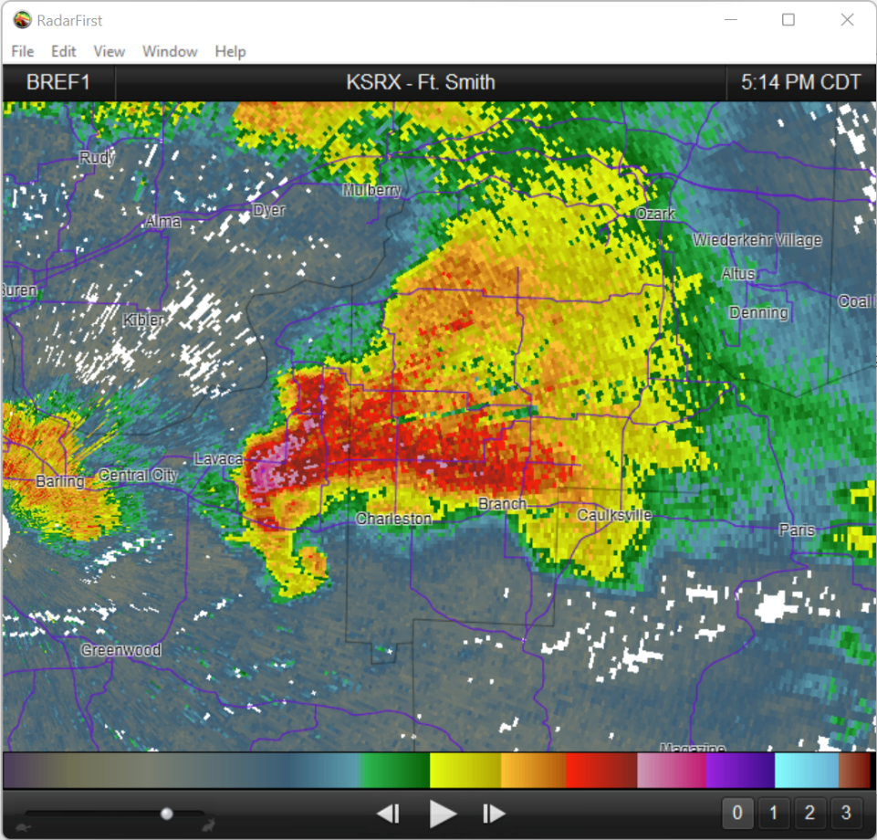
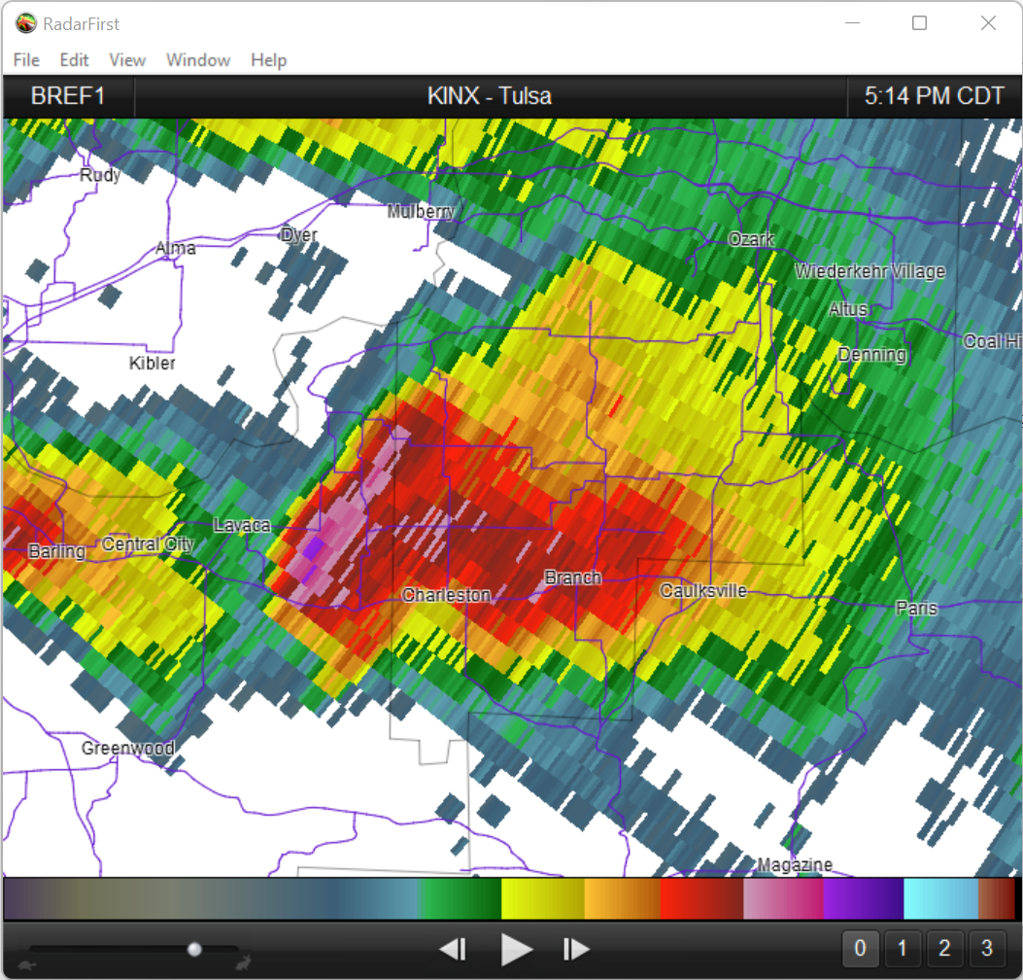
Beam Broadening Impacts Storm Appearance
Broadening of the radar beam causes storms at far ranges to be less defined
This is the same storm
KSRX
KINX
Notes:
This issue of beam broadening can have significant ramifications on the appearance precipitation features observed by radars. Shown here are two images of the exact same storm but taken from different radar sites. In the image on the left, a storm is observed from a radar just 15 miles away from it. Notice in this image the data have a lot detail and are very high resolution. Given the short distance away, the radar beam has not broadened much yet. It’s also measuring the lowest portion of the storm.
In the image on the right, the same exact storm is being observed but now from a radar approximately 105 miles away. At this distance away the radar beam has broadened considerably, thus the blockier, lower resolution appearance of the storm. Additionally, the greater distance away means we’re also measuring a much higher portion of the storm.
Ultimately both images are valuable and give important information, but due to distance and height, the appearance of the storm and the portions being measured are different.

Slide 23
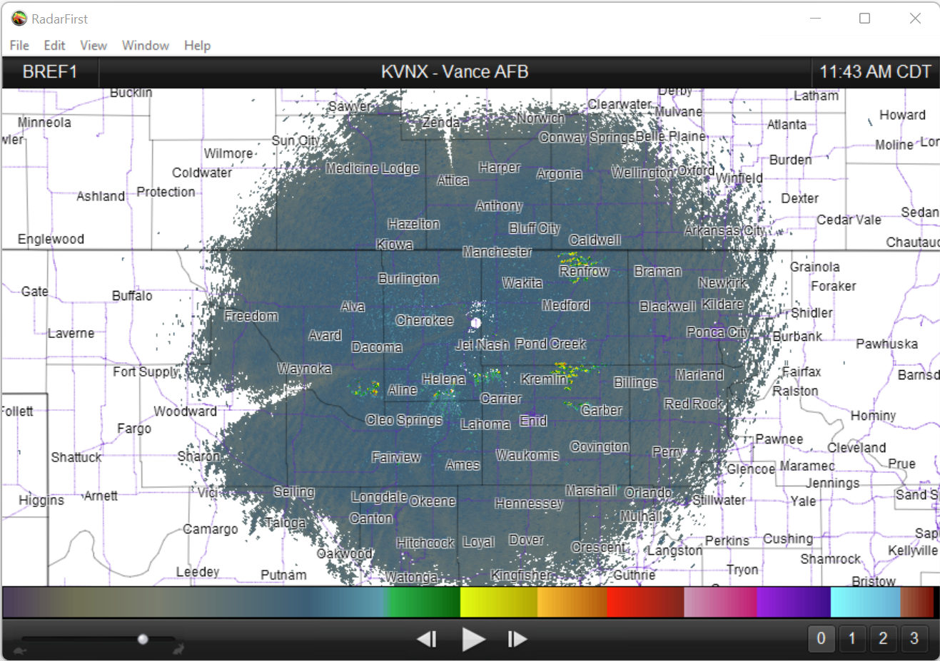
Beam Blockage
Vance Radar (KVNX) beam blockage at lowest tilt
Notes:
The third radar sampling issue we wanted to briefly cover is called beam blockage. Just as it sounds, it is a partial absence of data due to an obstruction near a radar site. For instance, the radar in northwest Oklahoma has some beam blockage to its south and west due to some trees just to the southwest of the radar. The trees are filtered out of the radar image, but the obstruction causes a small sliver of data to be absent.
Thankfully, this issue is not very widespread in Oklahoma, but it does happen in a few isolated spots such as this one.

Slide 24
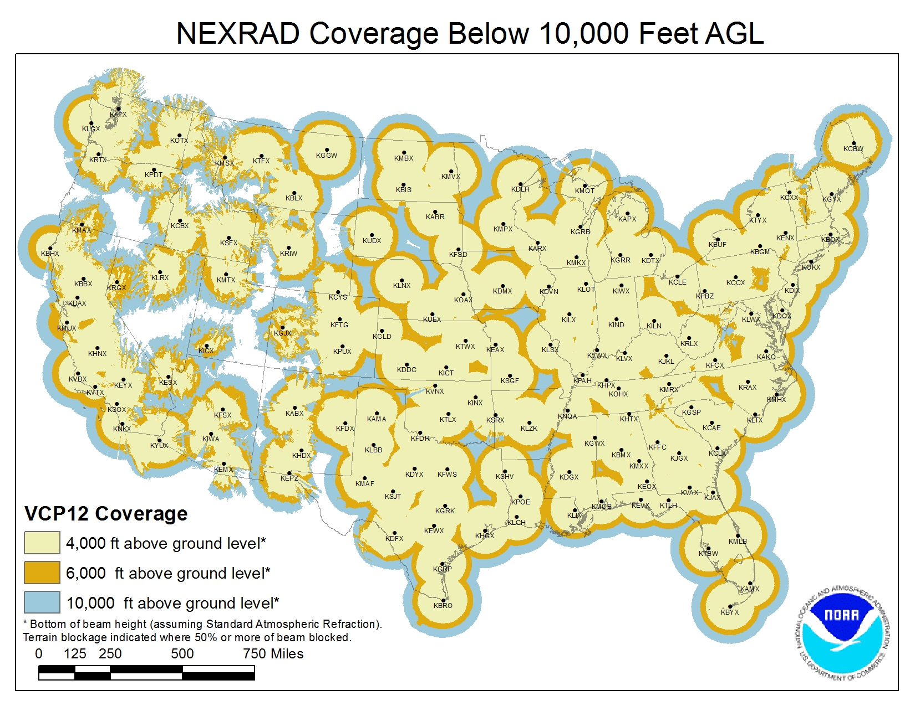
National Weather Service Radars Across the U.S.
Notes:
Next, let’s briefly talk about weather radar coverage. All together, the United States weather radar network is comprised of 142 radars across the continental United States. 18 additional radars are located in Alaska, Hawaii, Puerto Rico, and a few other locations due to military bases abroad. This map shows the locations and coverage of the radars across the lower 48 states. The colors correspond to the vertical coverage of the data. Locations in light yellow or orange have data below 10,000 feet above the ground, while locations in blue have no data below 10,000 feet. You’ll notice that some locations in the western United States have zero radar coverage due to mountainous terrain blocking the radar beam.

Slide 25
National Weather Service Radars in the Region
Blue = no radar data below 10,000 feet
Notes:
25
Zooming in closer to our region, we can see that National Weather Service radar coverage even in Oklahoma is quite uneven, despite 4 radars in state and many in our region. Locations in Oklahoma with no radar data below 10,000 feet include portions of the Panhandle, portions of northwest Oklahoma, and a rather large portion of southeast Oklahoma. Ultimately, it’s important to keep in mind that radar coverage is not identical everywhere due to the different radar sampling issues we’ve discussed.

Slide 26
Weather Radar Basics Summary
Radar stands for…
  RAdio Detection And Ranging
3 fundamental measurements…
  Distance to a target (Range)
  Intensity of targets (Reflectivity)
  Motion of targets (Velocity)
Various sampling issues…
  1) beam height with distance, 2) beam broadening, and 3) beam blockage
Radar coverage is not equal everywhere
Notes:
That wraps up the content for this module on weather radar basics. Let’s summarize what we’ve learned.
Radar is an acronym that stands for radio detection and ranging. It is the process of sending a pulse of powerful microwave energy away from a radar site and waiting for a portion of it to reflect off targets in the sky and make it back the radar site.
The three fundamental weather radar measurements are distance to a target, intensity of targets – which is called reflectivity, and the motions of targets – which is called velocity.
As great a tool as weather radar is, a portion of this module focused on some different radar sampling issues. Those included beam height with distance, beam broadening, as well as beam blockage. These factors affect the appearance of radar data, where it is measuring, and where it can’t measure. It’s important to note that while these are significant sampling issues, there are additional ones we did not cover in this radar basics presentation.
And finally, we briefly looked at the coverage of National Weather Service radars across the country and in Oklahoma and learned that the coverage is not equal everywhere.

Slide 27
Resources for Viewing Weather Radar
Notes:
Now that you have a better feel for the basics of weather radar, we wanted to provide you with a few free web resources you can use to view weather radar data.

Slide 28
Radar Viewing Tools
https://www.mesonet.org/weather/radar
  Radar composites (data from many individual radars stitched together)
  Individual radars throughout the region
  Reflectivity only
https://radar.weather.gov/
  Radar composites (data from many individual radars stitched together)
  Individual radars throughout the U.S.
  Reflectivity, Velocity, and a few others
https://ncei.noaa.gov/maps/radar/
  Archived radar back to 2014
Notes:
Here are links to three excellent web-based radar viewing tools.
The first link goes to a radar tool hosted on our website at mesonet.org. We offer radar composites, which are radar images made by combining data from multiple radar sites into a single image. We also offer data for individual radar sites across the Southern Plains. All products are reflectivity based, which is the information you’ve seen throughout this presentation showing storm intensity, location, and general structure.
The second link goes to a great radar tool from the National Weather Service. It provides some similar tools including radar composites and individual radar data for sites all across the United States. In addition to radar reflectivity this site also provides a few other radar products including velocity. Though we didn’t provide training on velocity in this module, this product helps to show winds within storms which helps to identify areas of convergence, divergence, and rotation.
Finally, the last link goes to a resource that provides archived radar composites dating back to 2014.
On the following slides I’ll briefly show you each of these three different radar viewing tools.

Slide 29
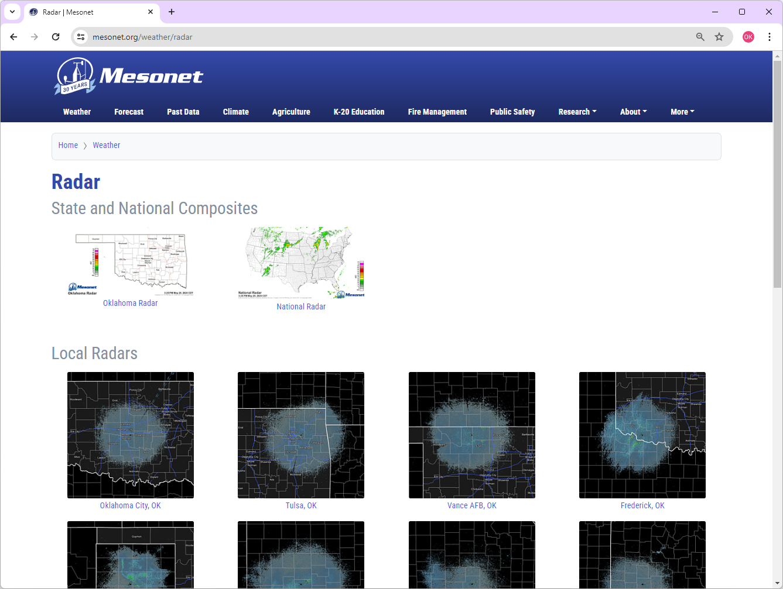
Mesonet Radar Page
https://www.mesonet.org/weather/radar
Notes:
Here’s a look at the radar tools on the Mesonet webpage. You can access them using the link appearing here.
If you click the Oklahoma or National radar images near the top those will bring you to a state and a national radar composite. These images are good at providing a big picture view of the weather but are not good for looking at finer scale details since these are composite images of many radar sites.
To have higher quality images, you’ll want to view data from an individual radar site, which appear a bit lower on the screen.

Slide 30
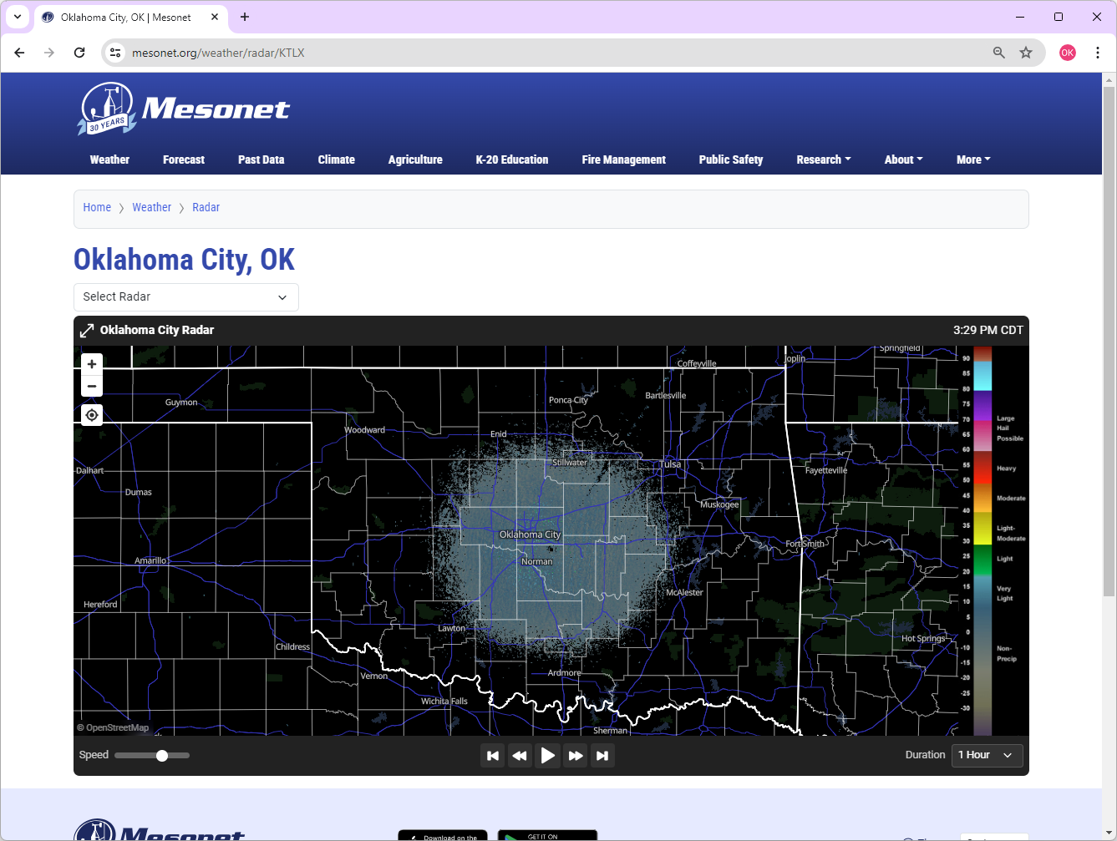
Mesonet OKC Radar Page
https://www.mesonet.org/weather/radar
Notes:
Here’s what the view looks like when you click on one of the individual radar sites. The product is interactive and allows you to zoom in and out, move the map around, animate up to 3 hours of data, change the speed of the animation, and switch to different radar locations. On the far right side you’ll also find an annotated legend that provides a general description for different reflectivity values.
Next up, let’s check out the National Weather Service online radar tool.

Slide 31
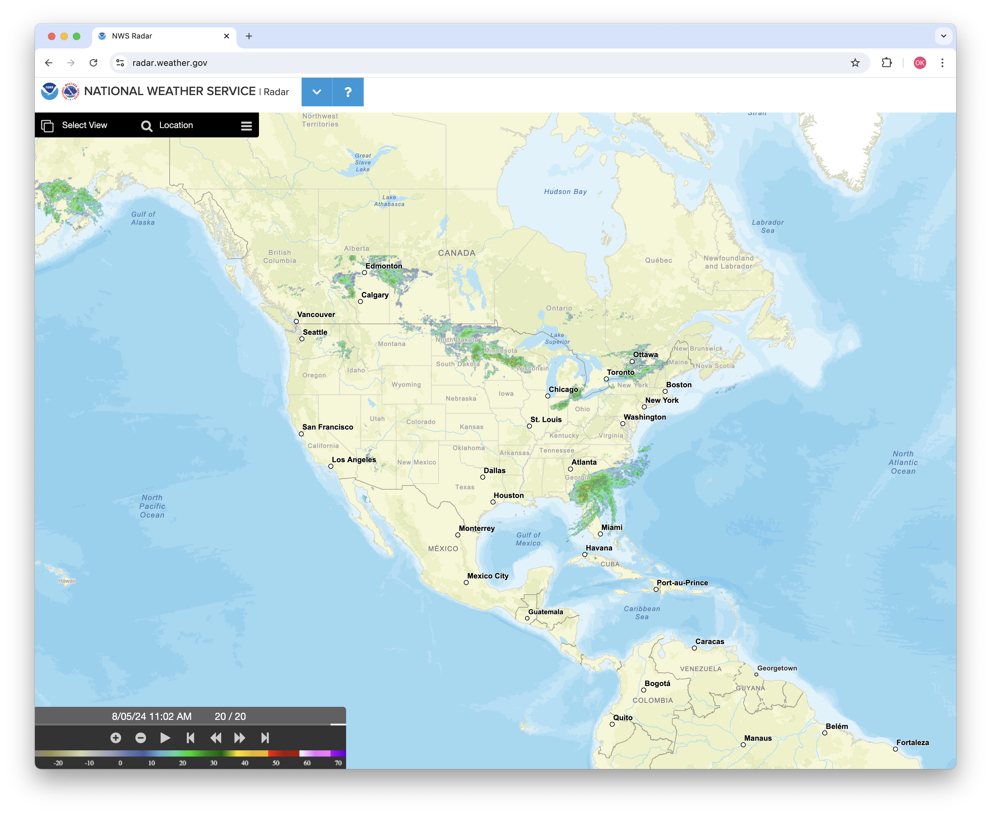
NWS Radar Tool
https://radar.weather.gov
Notes:
Here’s the National Weather Service’s online radar tool available at radar.weather.gov. It’s also an interactive tool that allows you to zoom in and out, pan the map around, and animate data. It starts at a national scale with a large composite map but you can adjust the map to a particular region of interest.

Slide 32
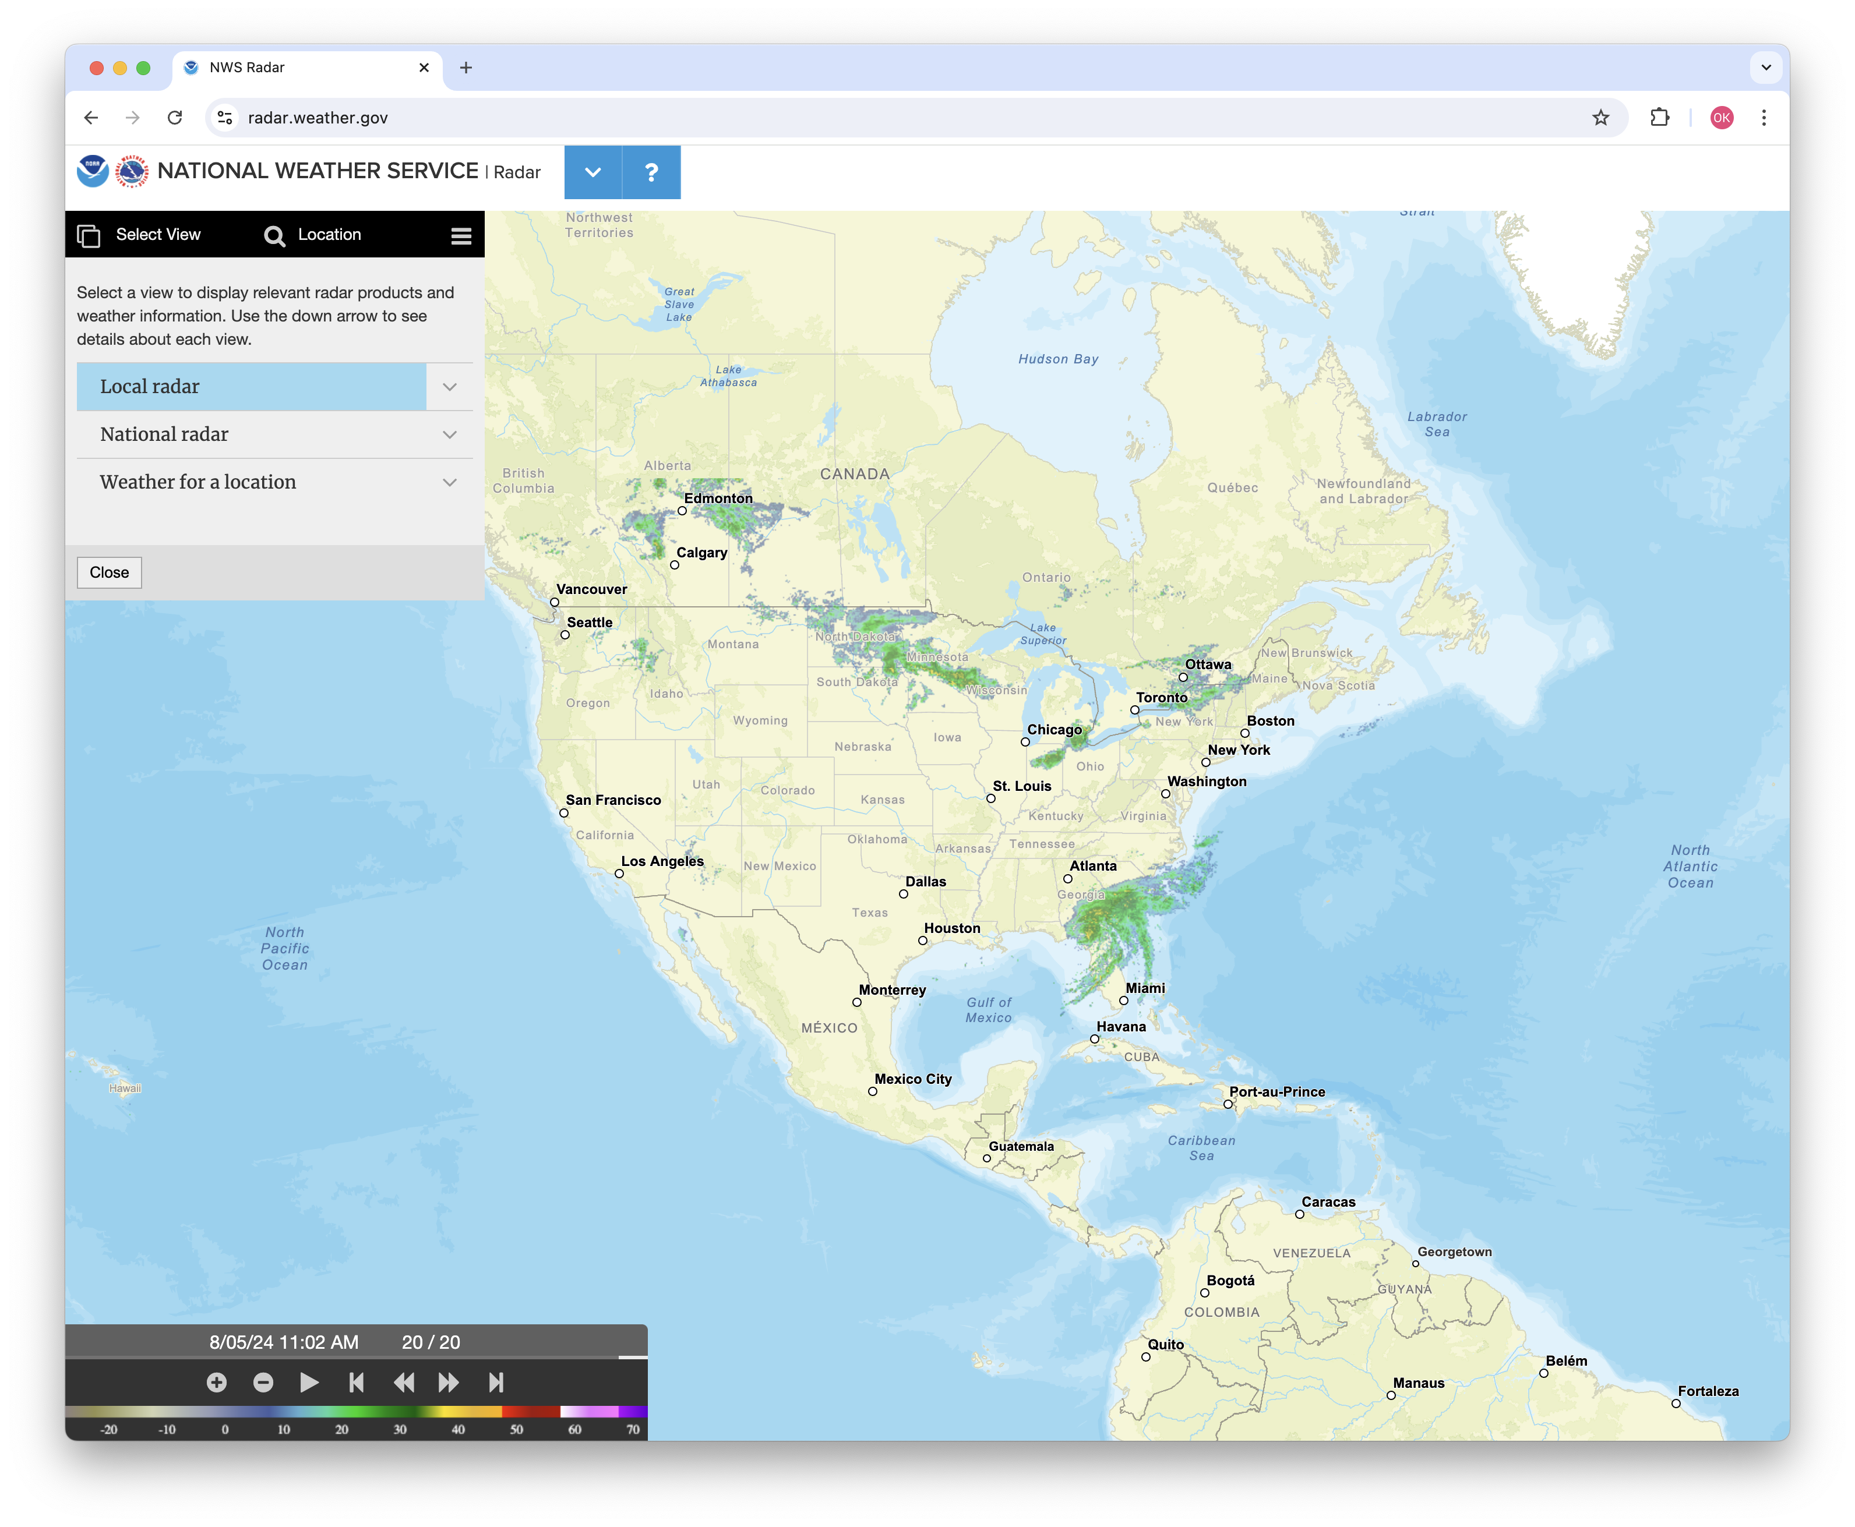
Local Radar Menu
https://radar.weather.gov
Notes:
If you prefer to look at individual radar site data, you can also view that by clicking Select View from the upper left corner followed by local radar.

Slide 33
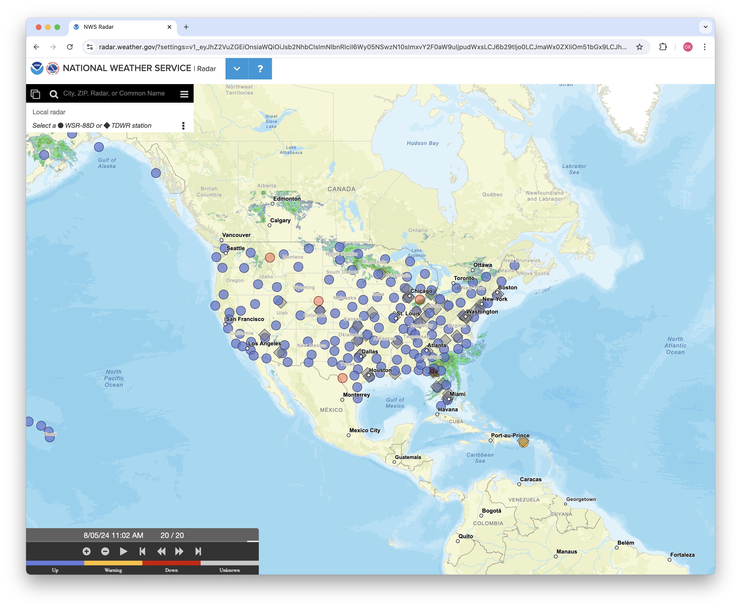
Select a Radar
https://radar.weather.gov
Notes:
You then get a map of radars from across the United States to choose from. Let’s click a radar site where there is some interesting weather currently.

Slide 34
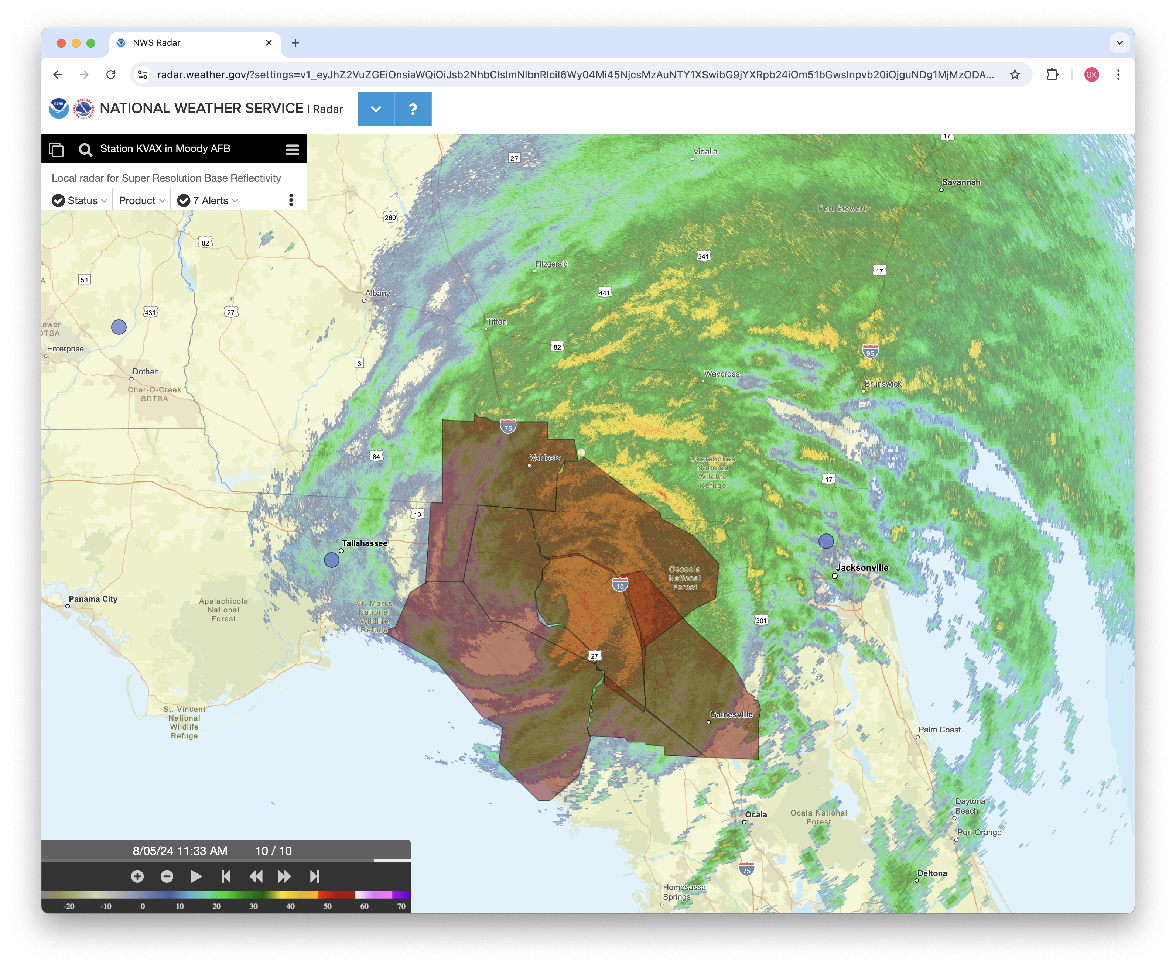
Florida Radar with Warning Boxes
https://radar.weather.gov
Notes:
The view then zooms in close to the radar site you selected. From here we can further navigate the map as needed, animate, switch to a different radar site, and even hide different layers appearing on the screen.
For instance, sometimes the radar view may be obscured somewhat due to active weather warnings and advisories as was the case on this day when there were numerous flash flood warnings in effect due to Hurricane Debby. If you would like to hide those, click on the three dot icon just to the right of Alerts.

Slide 35
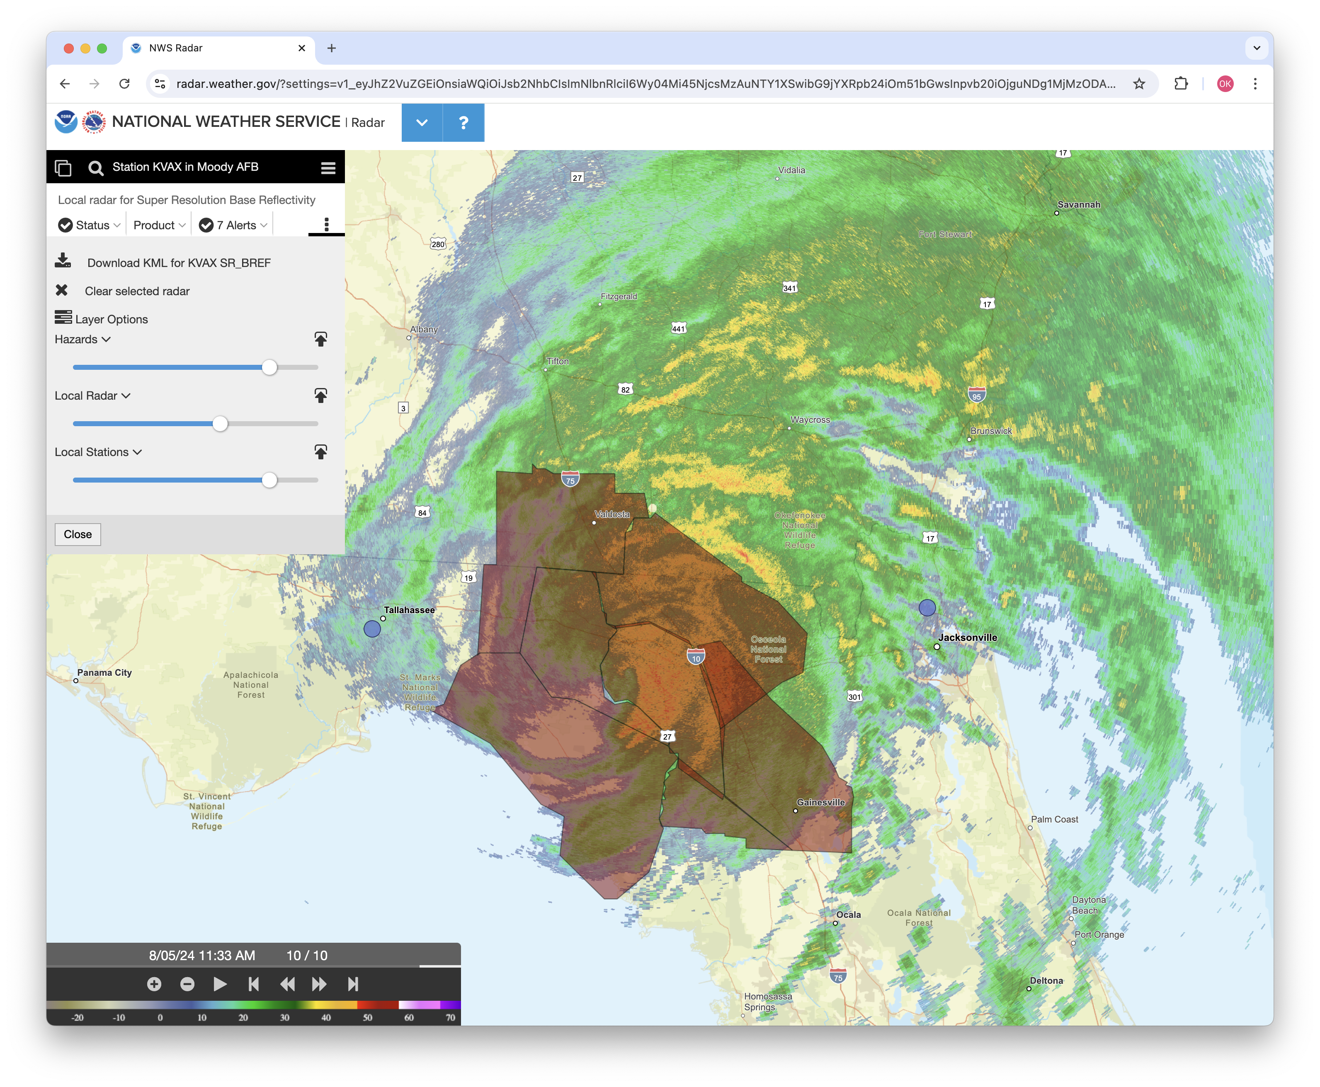
Menu to Set Layer Opacity
https://radar.weather.gov
Notes:
The menu pops down and shows the different layers that are currently visible. You can change the opacity of any of those as needed using the slider bars.

Slide 36
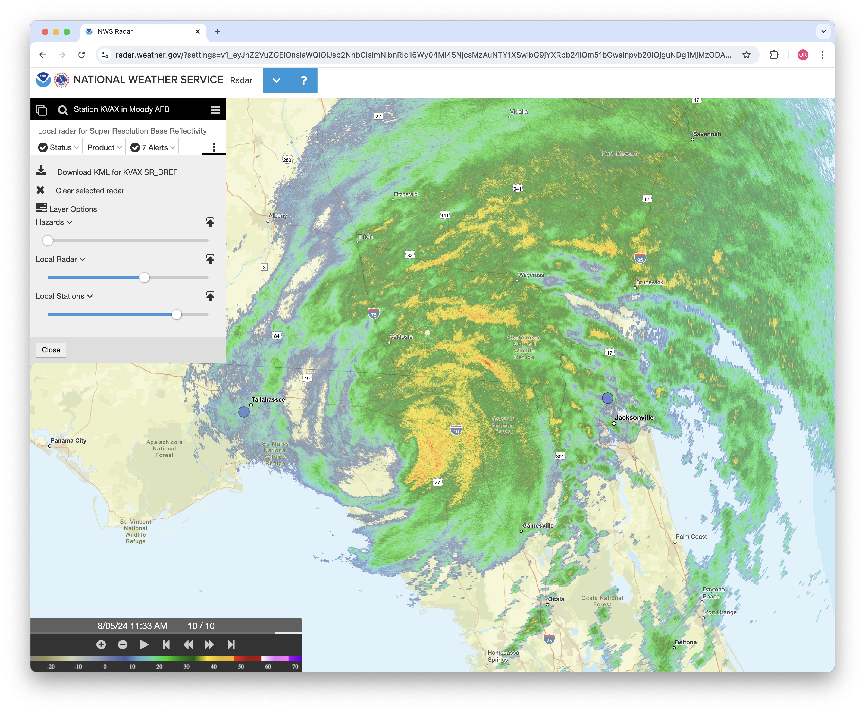
No Warning Boxes Visible
https://radar.weather.gov
Notes:
To hide the alerts, I went ahead and slid the slider bar for hazards all the way to the left side so we can see the radar data more clearly.

Slide 37
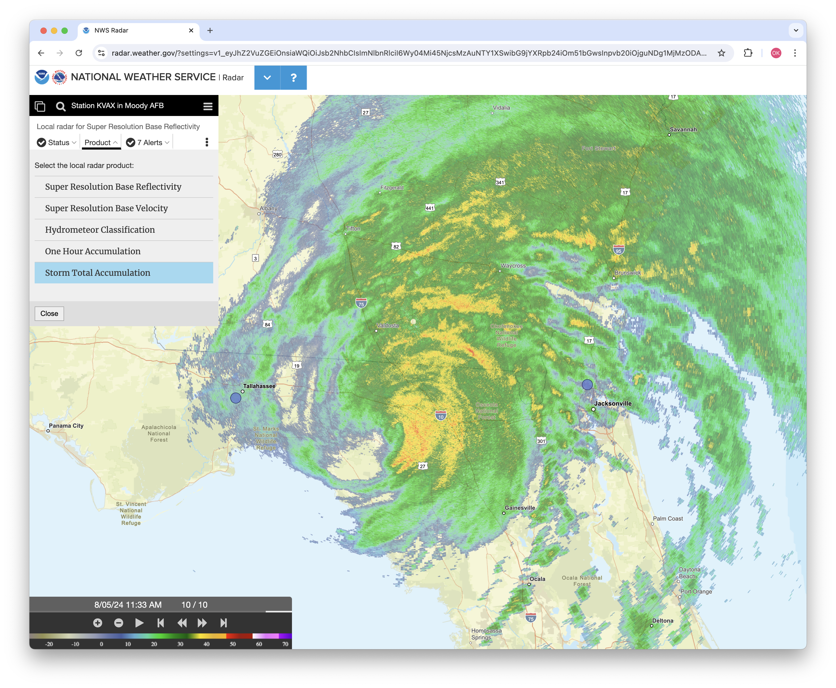
Other Available Radar Products
https://radar.weather.gov
Notes:
Additional radar products are also available using this online tool. In the menu in the upper left if you click product, a drop down window will appear showing additional radar products available for viewing. For instance, if you wanted to see how much rainfall the radar estimated has fallen during an event you could see that by clicking Storm Total Accumulation.

Slide 38
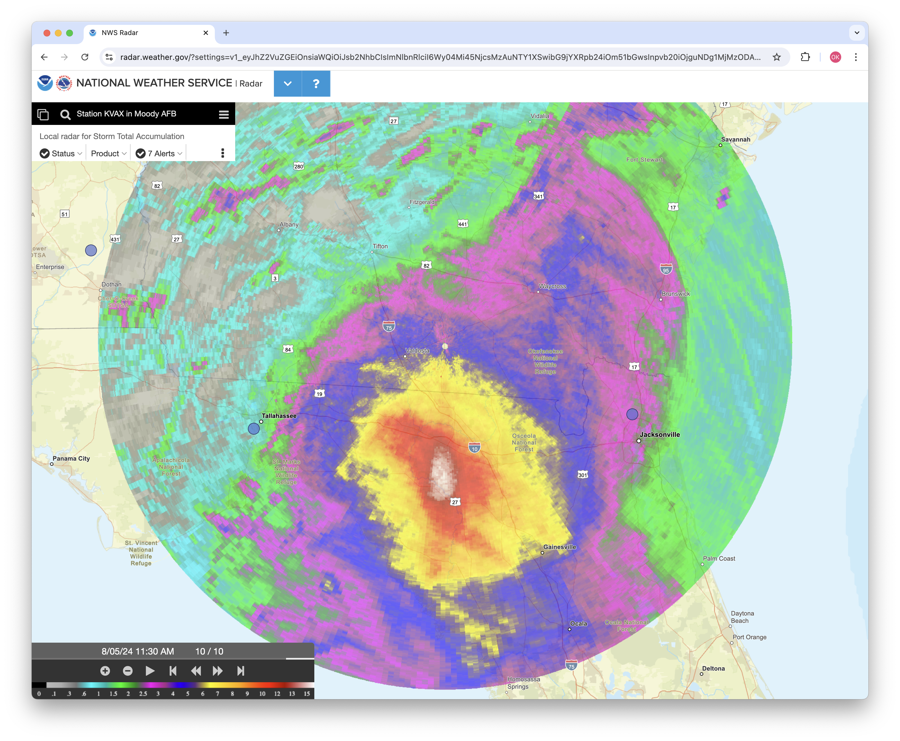
Rainfall Estimate Radar Product
https://radar.weather.gov
Notes:
That switches our view to an entirely different radar product with a unique color palette and legend. For this particular example the radar estimated that nearly 15 inches of rainfall had occurred northwest of Gainesville, Florida due to landfalling Hurricane Debby.
Let’s move on to our third and final web-based radar tool.

Slide 39
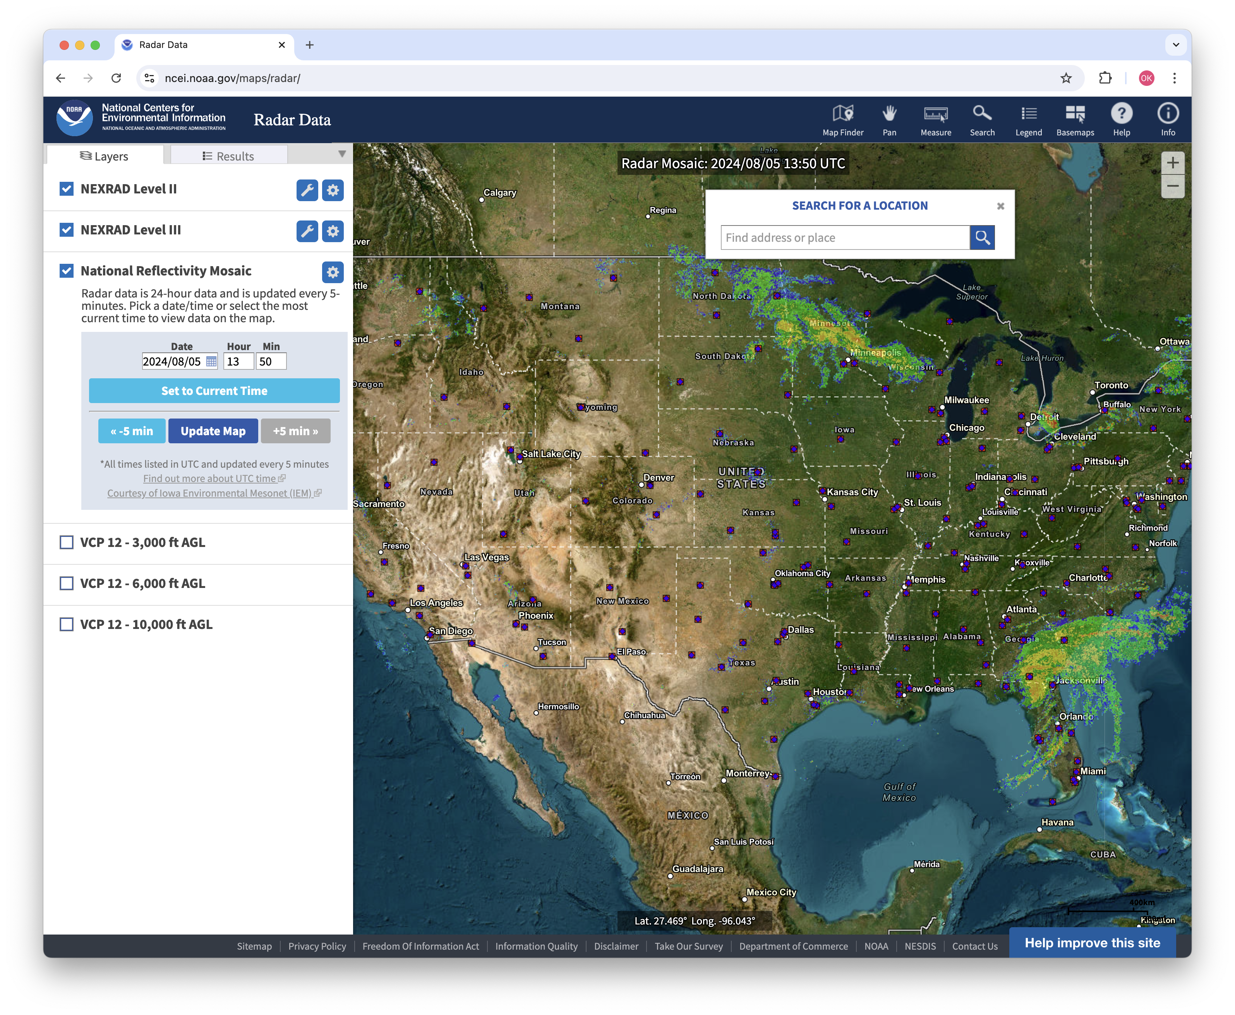
NCEI Radar Archive
https://ncei.noaa.gov/maps/radar/
Notes:
Our last recommended online radar viewing tool comes to us from the NOAA National Centers for Environmental Information or NCEI for short. NCEI is a federal agency that manages one of the world’s largest archives of atmospheric, coastal, geophysical, and oceanic data.
Their radar product viewer is available from the link appearing at the top and is shown here.
A great feature that their tool provides that the others I’ve shown you don’t have is an ability to view national radar composites from past events. Using the date and time boxes on the left side of the screen you can enter in dates as far back as 2014 to get a big picture view of radar data to see where storms and precipitation were in the past.

Slide 40
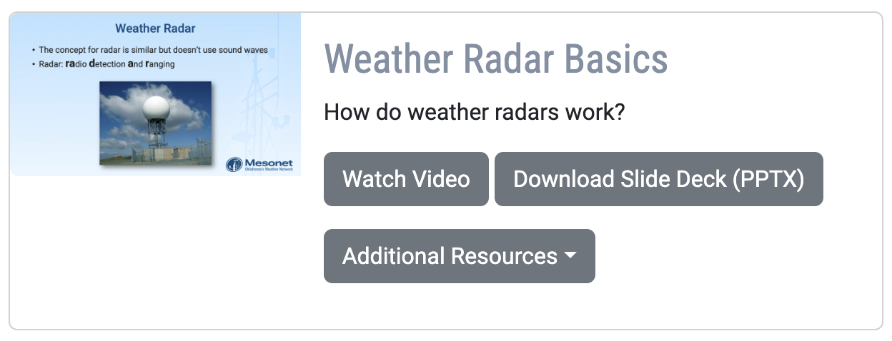
Mesonet K-20 Learning Modules
https://mesonet.org/education/learning-materials
Notes:
That wraps it up for this learning module. To find additional resources that go along with this video, you can check those out using the link appearing on the screen.
Also, if you have any questions at all, please don’t hesitate to reach out to us using the Contact form in the More menu of the Mesonet webpage. Just select K-20 Education for the Inquiry Type and drop us your comment, question, or suggestions there. Thanks for joining us!

